Slide 1


What is
Power BI

Slide 2





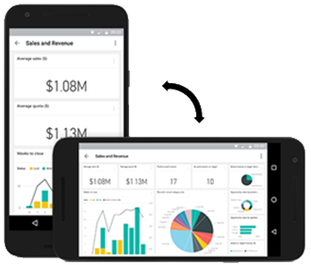
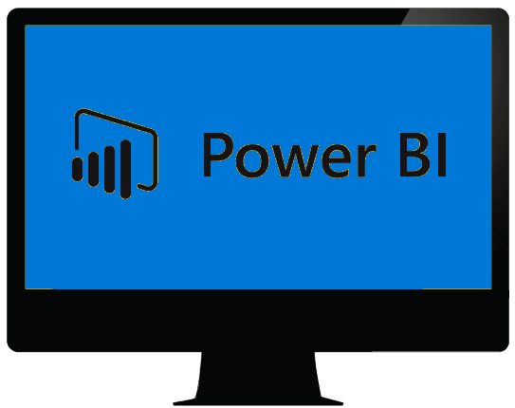
Power BI Report Builder
Data
Gateway
Power BI Mobile App
Desktop

Slide 4
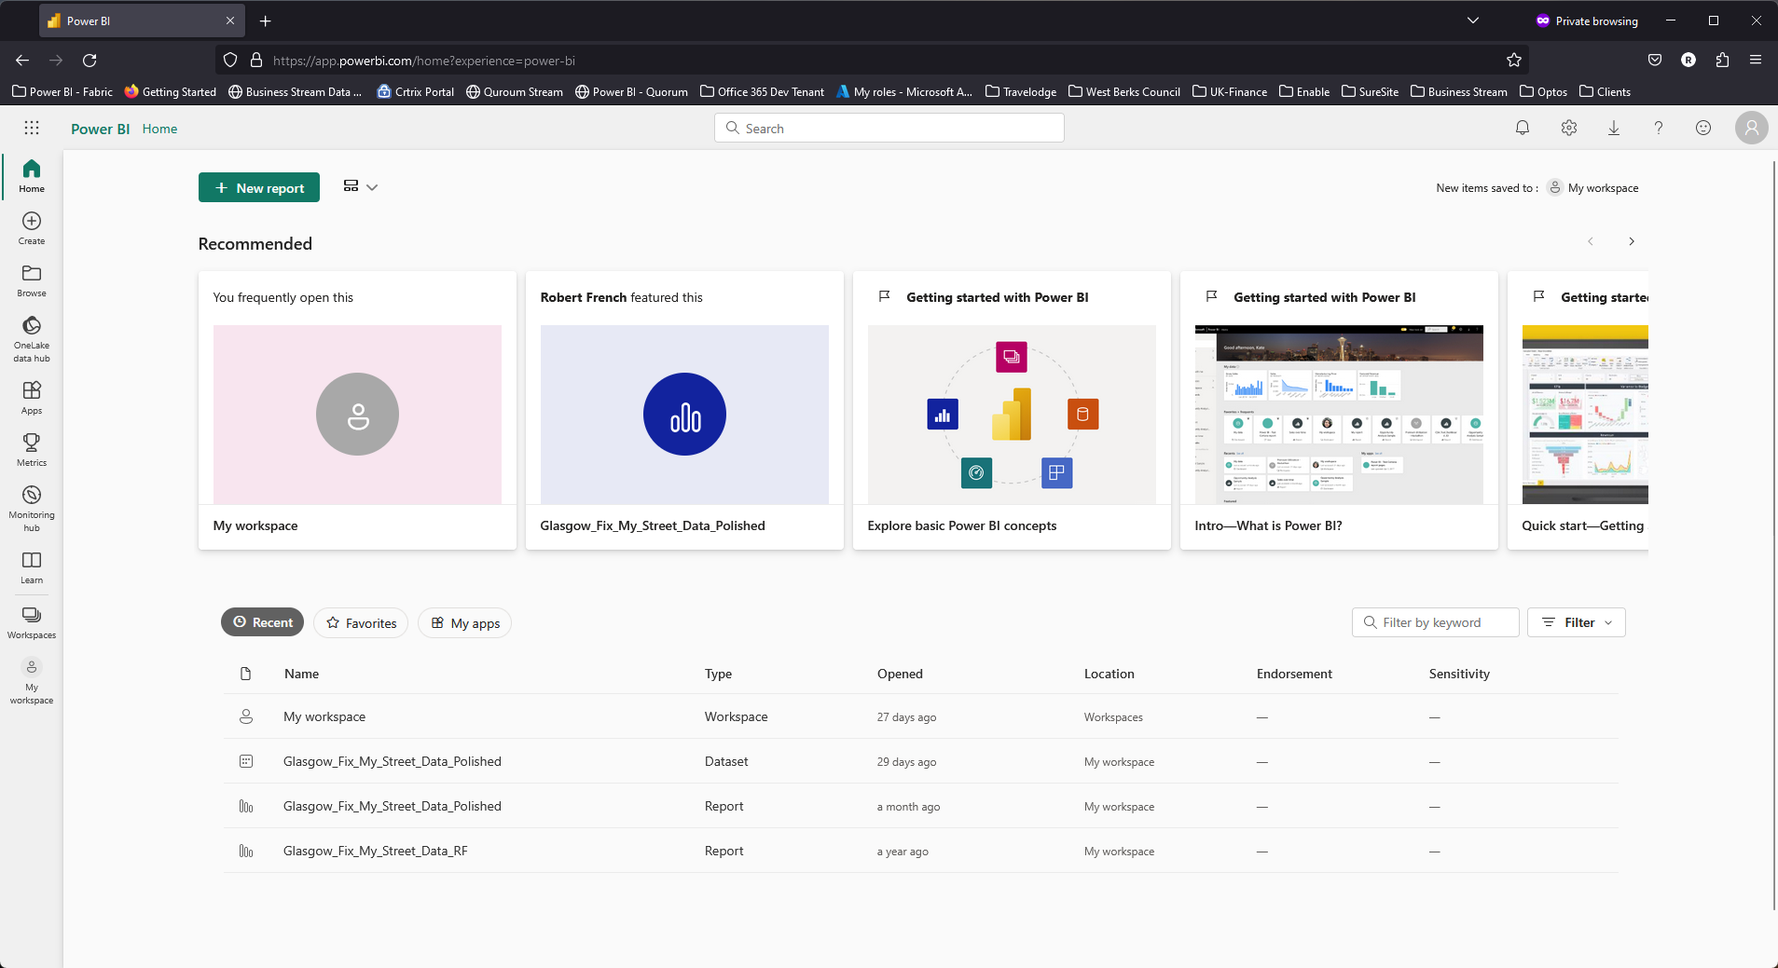

Slide 5
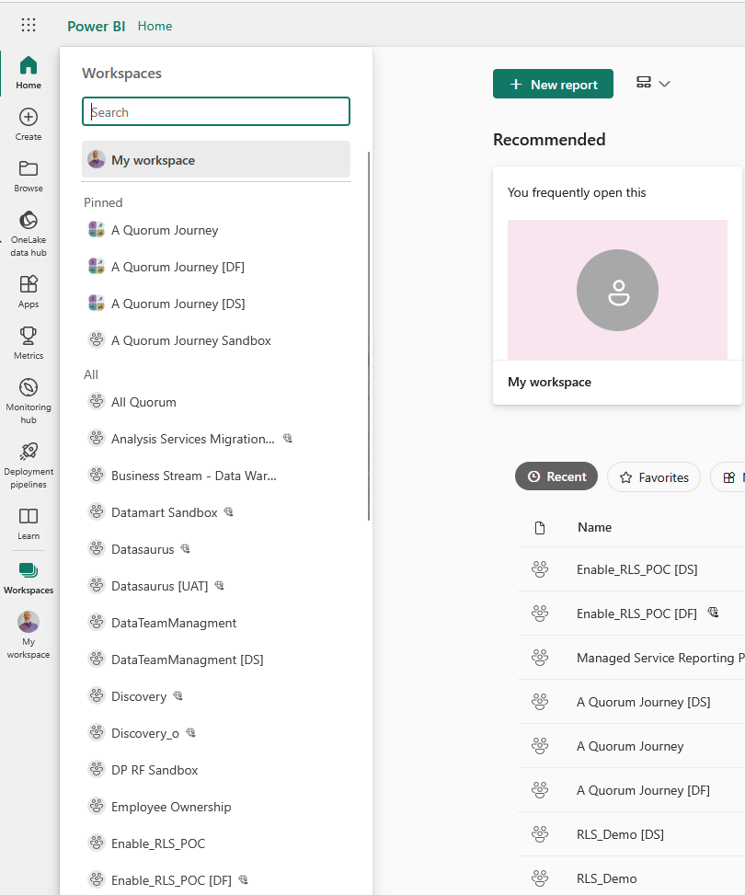
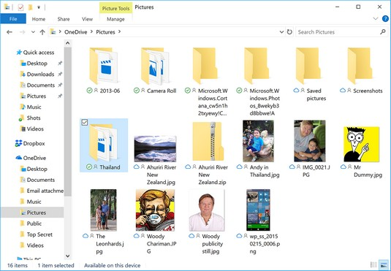

Slide 6
How many different types of workspace are there?

Slide 7

Two

Slide 8
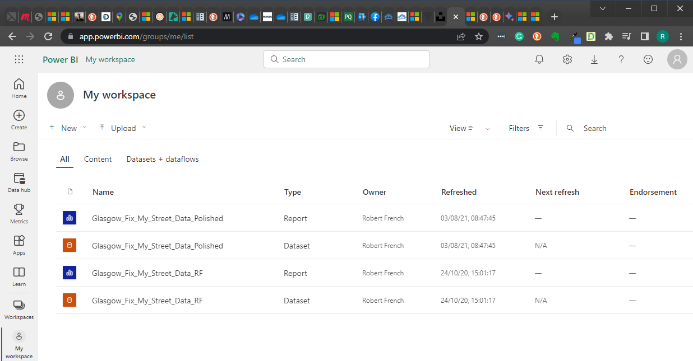
My Workspace

Slide 9


Slide 10
Every user has a ‘My Workspace’
(system generated)
Even users with a Power BI Free Licence.
By default only that user can access the workspace
(the users can share content)

Slide 11


Slide 12
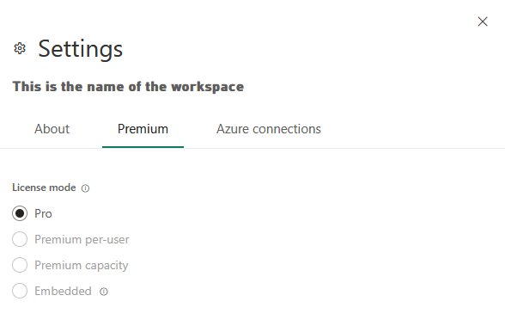
The type of license will determine what features you can access.

Slide 13
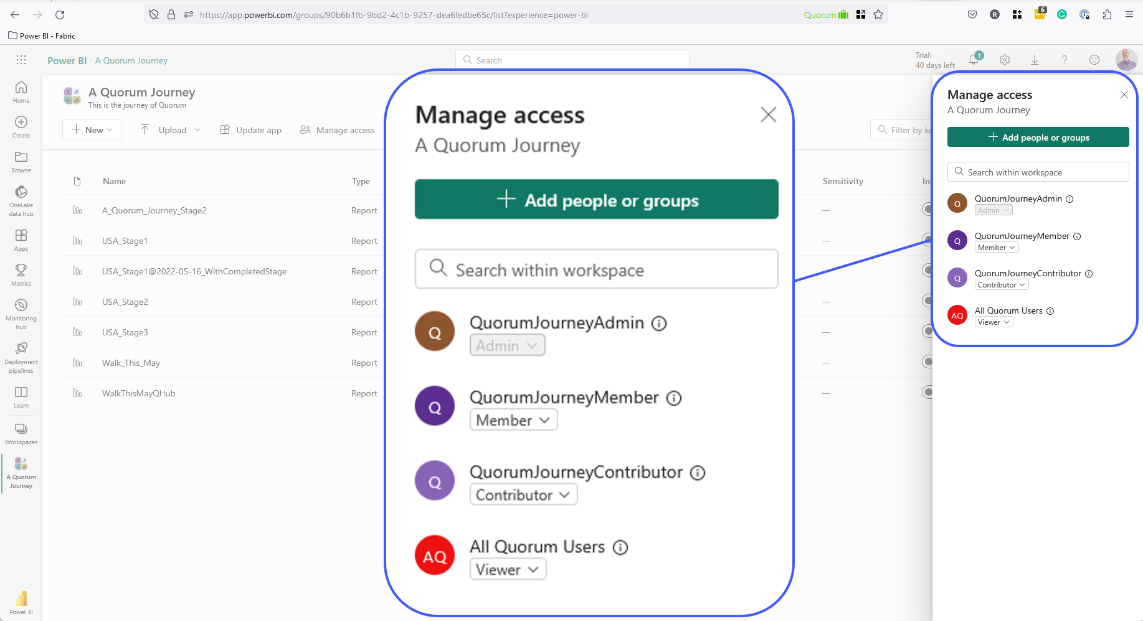

Slide 14

Luke
Use the AAD Groups

Slide 15
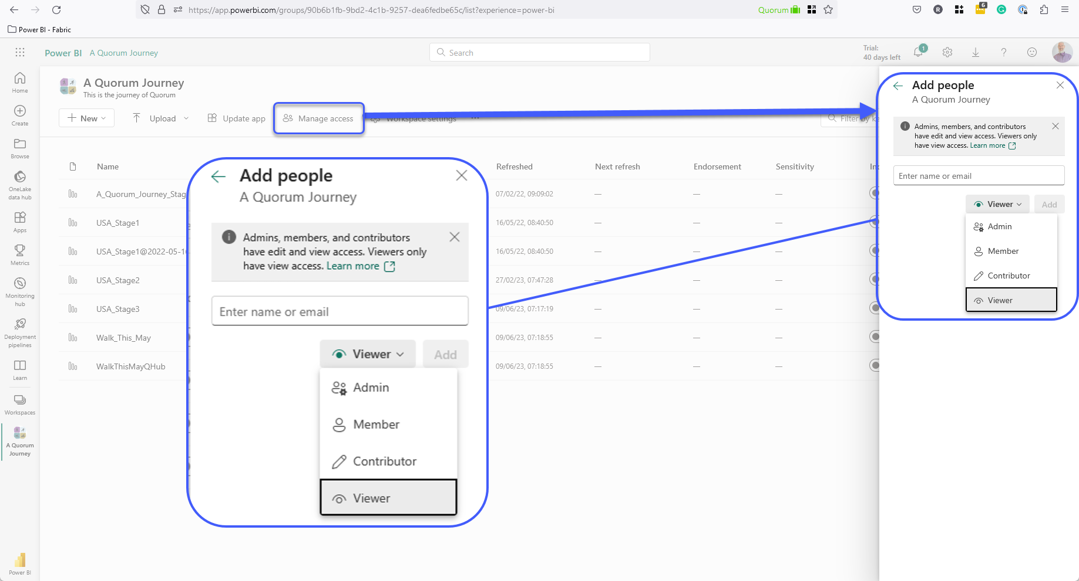

Slide 16
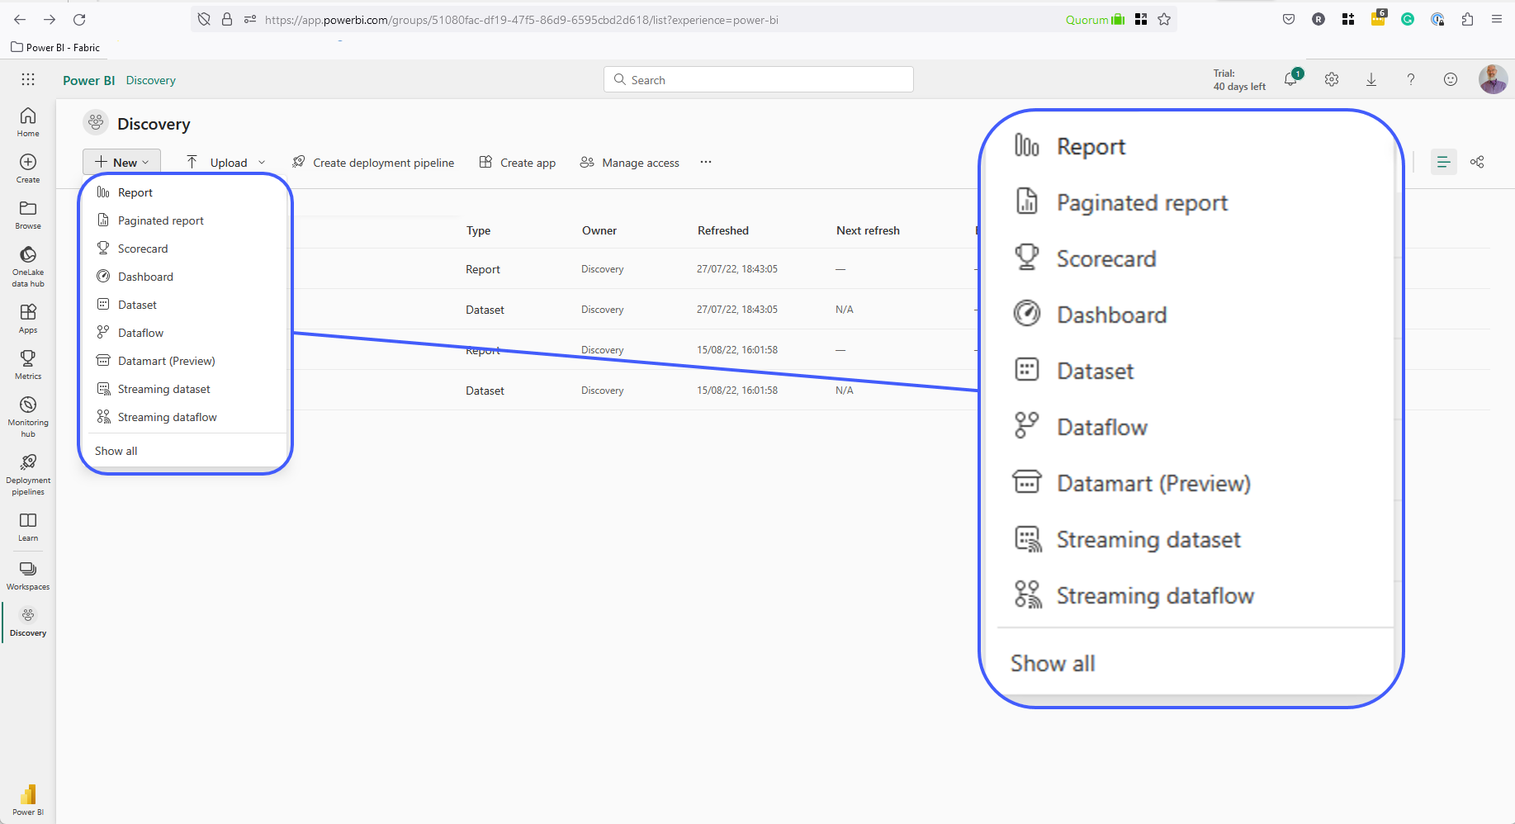

Slide 17
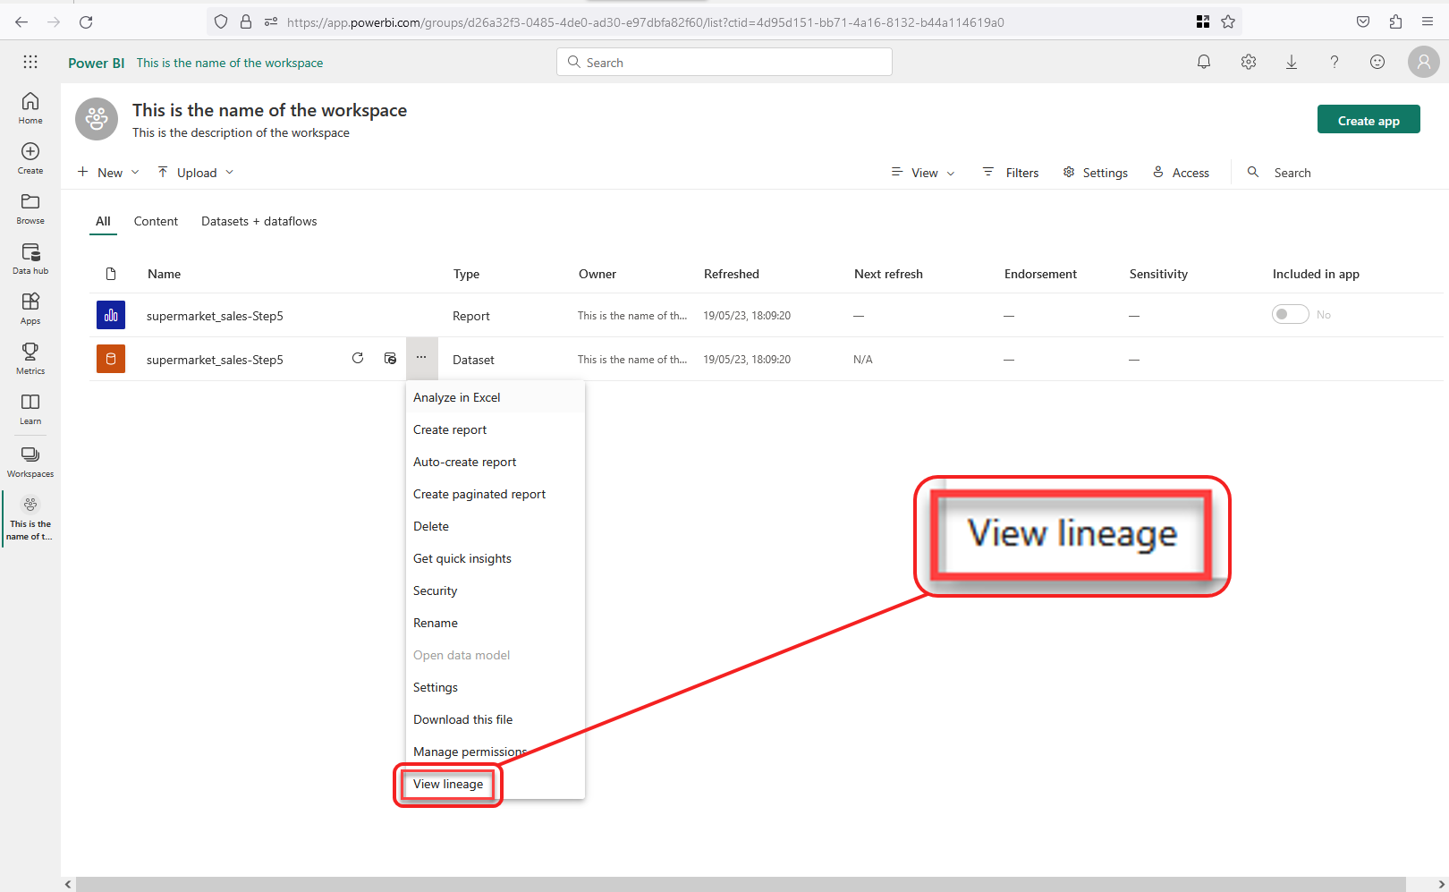
Notes:
Photo by Windows on Unsplash

Slide 18
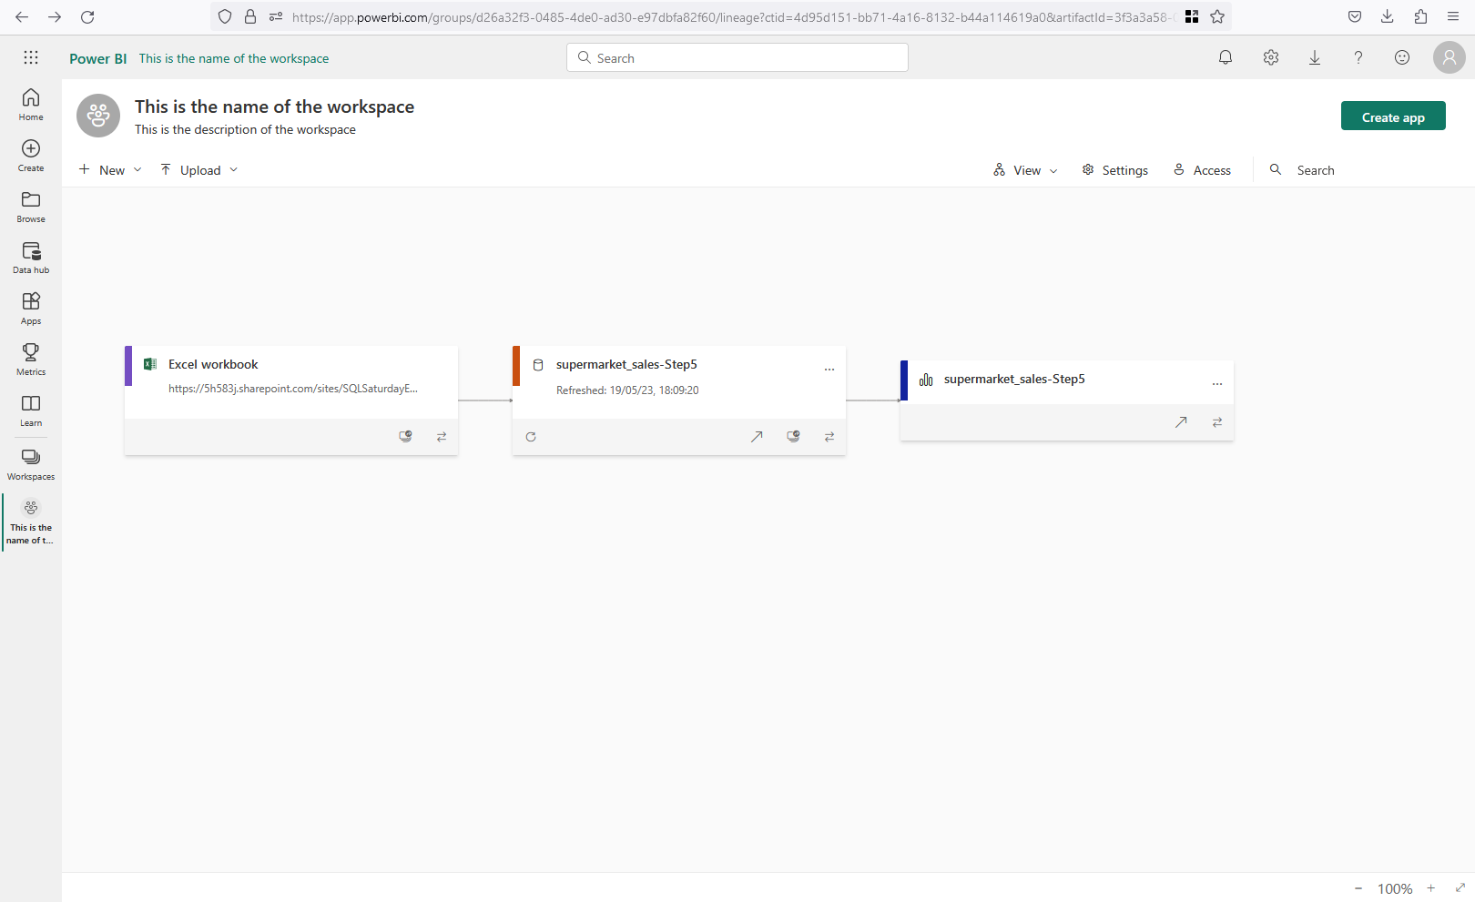
Notes:
Photo by Windows on Unsplash

Slide 19
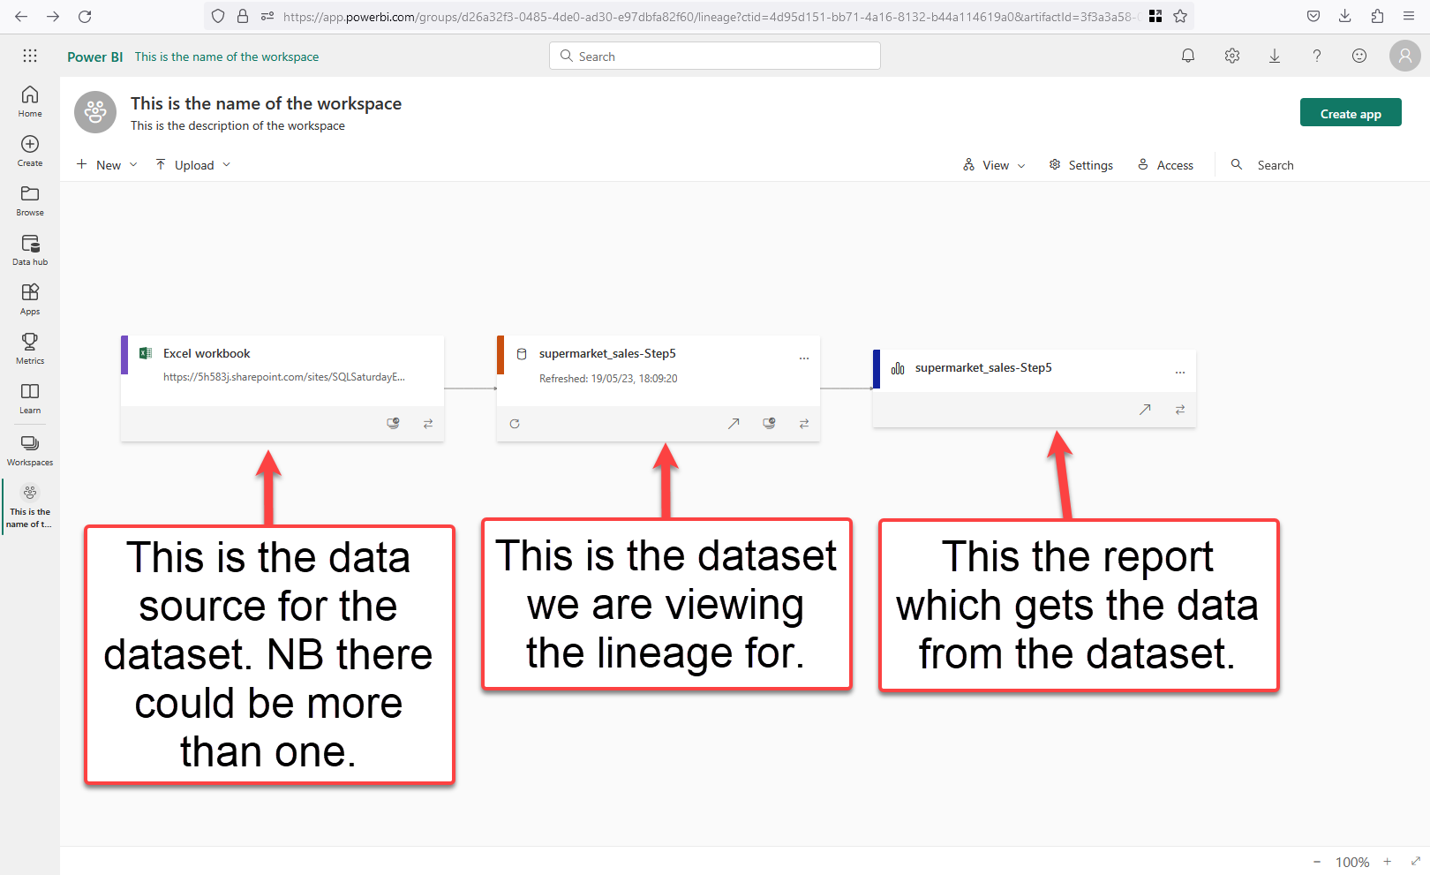

Slide 20
Advantages to separating
Datasets and Reports
Different people can handle data model and report creation
Report page flexibility
Less dataset maintenance
Easier for report creators to find datasets
Reduces the number of dataset refreshes
Lessen security and compliance concerns
Reduces risk of inconsistences and inaccuracies
https://www.coatesdatastrategies.com/blog/5-tips-for-separating-power-bi-datasets-and-reports

Slide 21



One dataset
Many reports
Workspace A
Dataset
Workspace B

Slide 22
Data
Gateway

Slide 23
Power BI Data
Gateway

Slide 24

Notes:
Photo by Possessed Photography on Unsplash

Slide 25
 | Standard Gateway | Personal Gateway
Which cloud services does it work with | Power BI, Power Apps, Azure Logic Apps, Power Automate, Azure Analysis Services, DataFlows | Power BI
Can used with multiple user per data source | Yes | No
Run as an app for users who are not administrator's | No | Yes
Run as single user with user credentials | No | Yes
Import data and set up scheduled refresh | Yes | Yes
Direct Query Support | Yes | No
Support for live connection to Analysis Services | Yes | No
https://powerbi.microsoft.com/en-gb/gateway/
Notes:
https://powerbi.microsoft.com/en-gb/gateway/

Slide 26




Notes:
Have on premise data

Slide 27
Notes:
Have on premise data

Slide 28

Notes:
Photo by FLY:D on Unsplash

Slide 29

Data
Gateway
Desktop

Slide 30
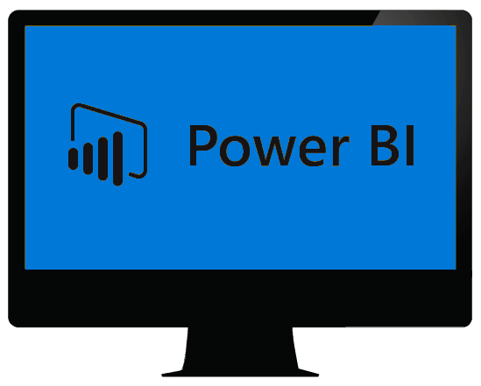
Power BI Desktop what do you get?

Slide 31

Notes:
This application is installed on your desktop computer

Slide 32

Notes:
How much does it cost?

Slide 33
Cost = £0.00p

Slide 34




Really
Notes:
Photo by SHVETS production: https://www.pexels.com/photo/text-on-a-black-surface-8410756/

Slide 35

So what?
Why should I care?
Notes:
So what do you get?

Slide 36


Slide 37

Notes:
Photo by ELEVATE from Pexels
Also get a fantastic ETL tool as well built into Power BI Desktop
Informatica
Alteryx
Talend
QlikView Expressor
Tableau Data Prep
SQL Server Integration Services SSIS

Slide 38
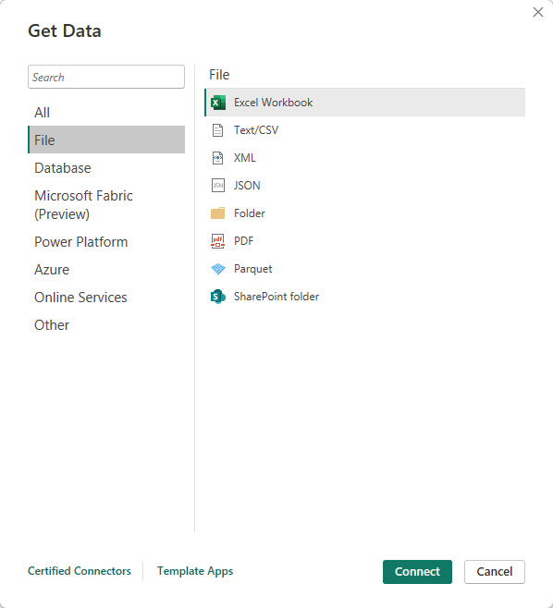
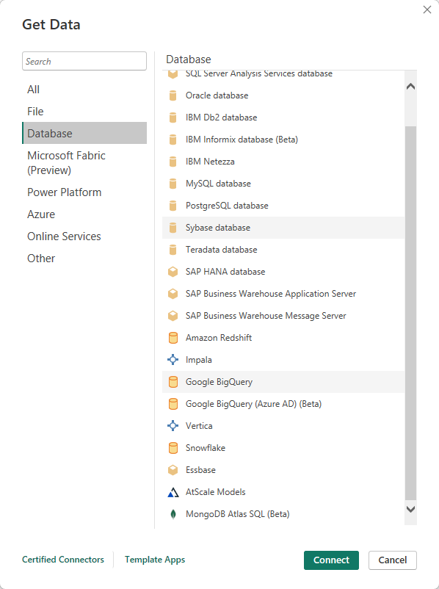
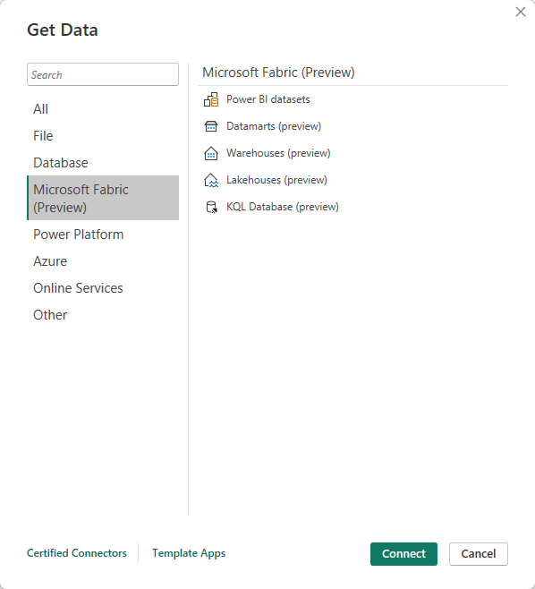

Slide 39
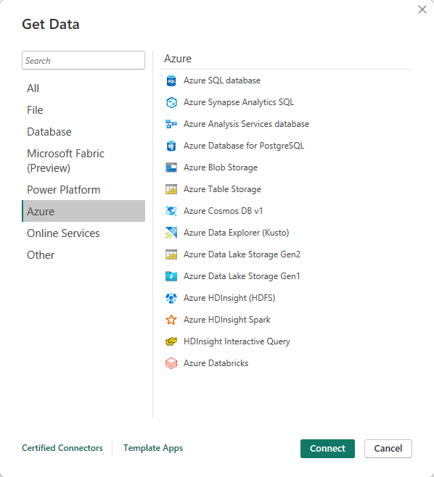
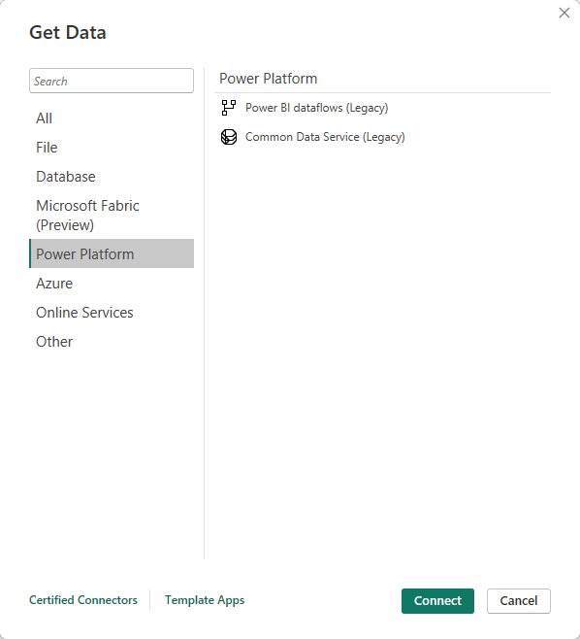

Slide 40
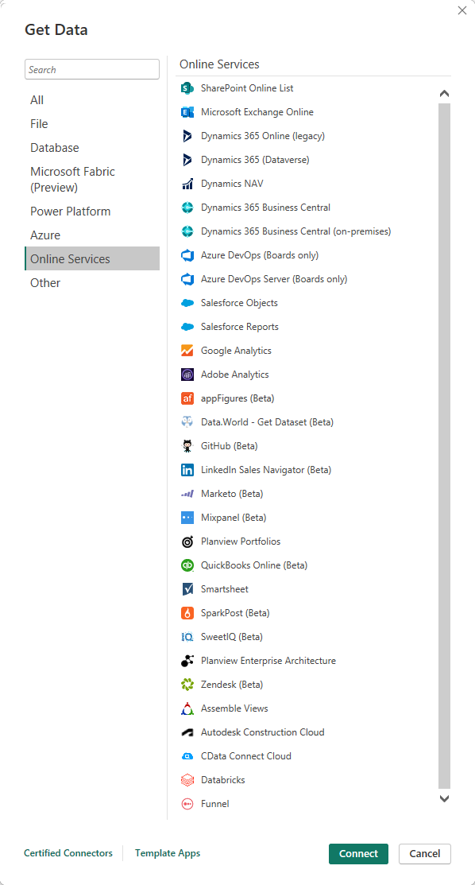
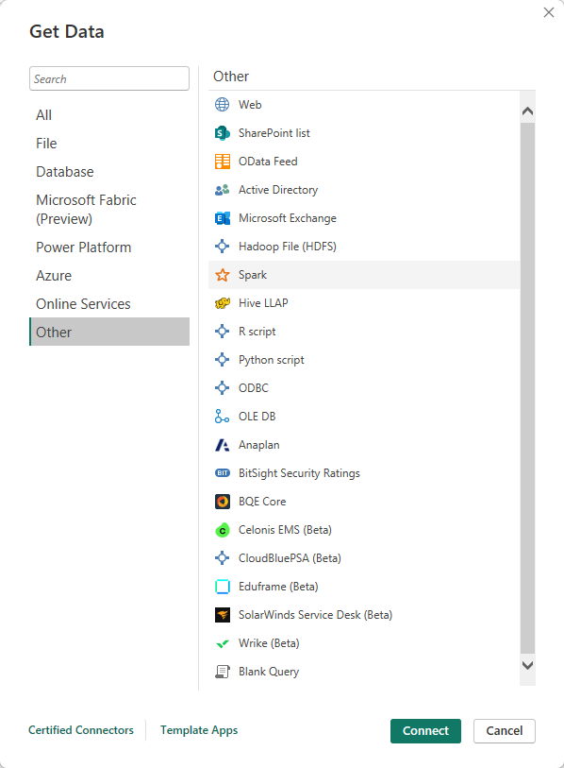

Slide 42

Notes:
Photo by Pixabay from Pexels
There is also a Datawarehousing tool built into Power BI Desktop

Slide 43
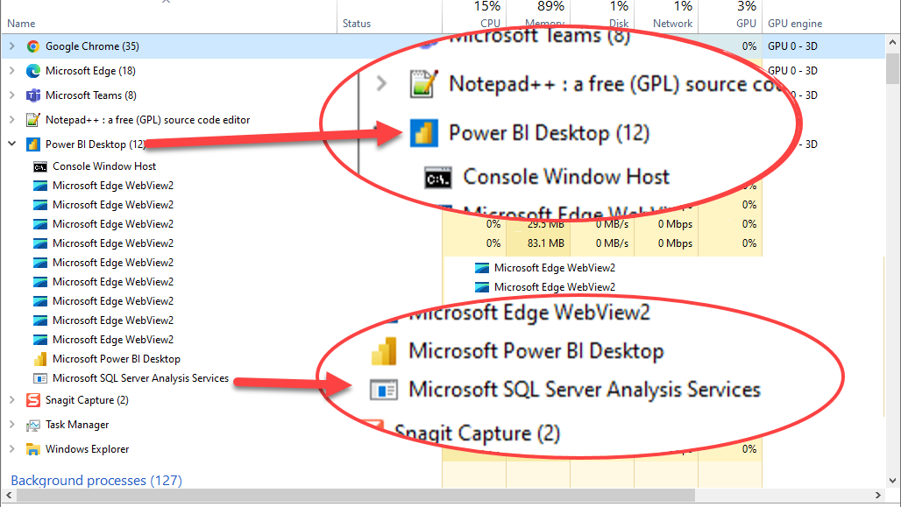
Notes:
Power BI desktop is running an instance of SQL Server Analysis Services

Slide 44


Slide 45


Slide 46
Notes:
Photo by ELEVATE from Pexels
Also get a fantastic ETL tool as well built into Power BI Desktop
Informatica
Alteryx
Talend
QlikView Expressor
Tableau Data Prep
SQL Server Integration Services SSIS

Slide 47

AKA – M code

Slide 48
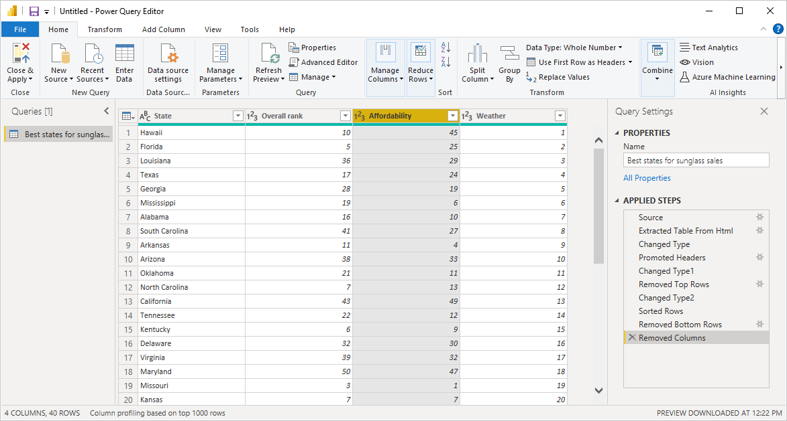

Slide 49
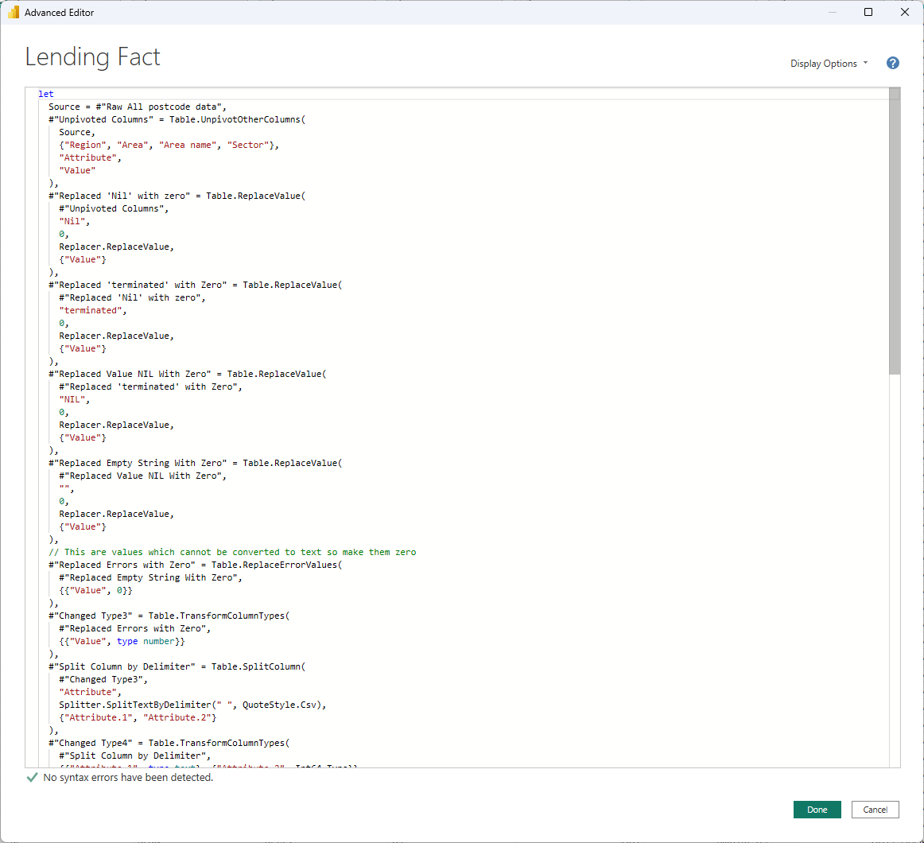
Notes:
There is proper code in the background if want access to the code

Slide 50
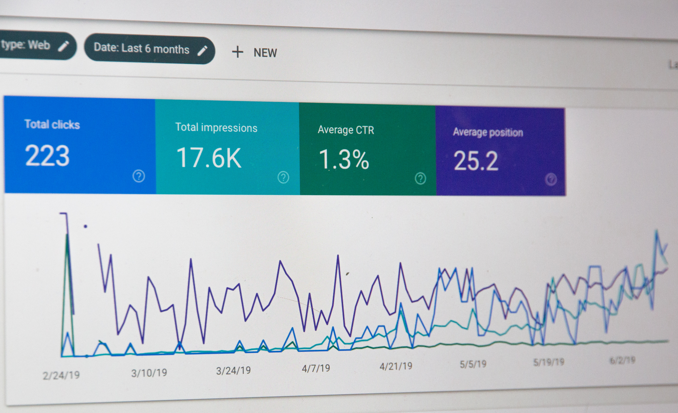

Slide 51

Data Analysis Expressions (DAX)

Slide 52
Count_France =
COUNTAX (
FILTER ( TDF_Winners, TDF_Winners[Country] = "France" ),
TDF_Winners[Country]
)
Count All Other Countries =
COUNTROWS (
CALCULATETABLE (
TDF_Winners,
TDF_Winners[Country] <> "Spain",
TDF_Winners[Country] <> "France"
)
)

Slide 53
-- All time intelligence function are designed to return a table
-- to be easily used in CALCULATE as a filter.
DEFINE
VAR StartDate = DATE ( 2008, 01, 01 )
VAR EndDate = DATE ( 2008, 01, 31 )
EVALUATE
CALCULATETABLE (
{ (
CALCULATE (
[Sales Amount],
FIRSTDATE ( 'Date'[Date] ) -- 2008-01-01
),
CALCULATE (
[Sales Amount],
LASTDATE ( 'Date'[Date] ) -- 2008-01-31
)
) },
'Date'[Date] >= StartDate
&& 'Date'[Date] <= EndDate
)

Slide 54
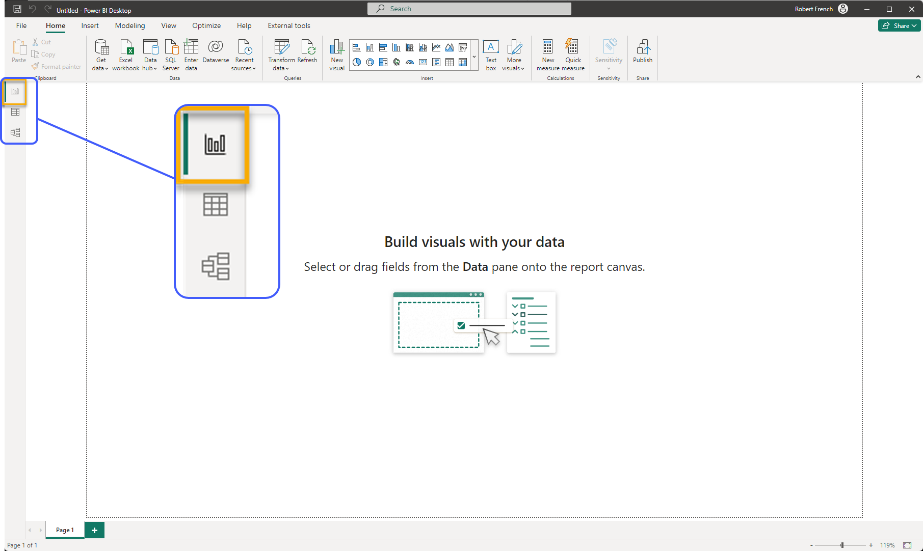
Report View

Slide 55
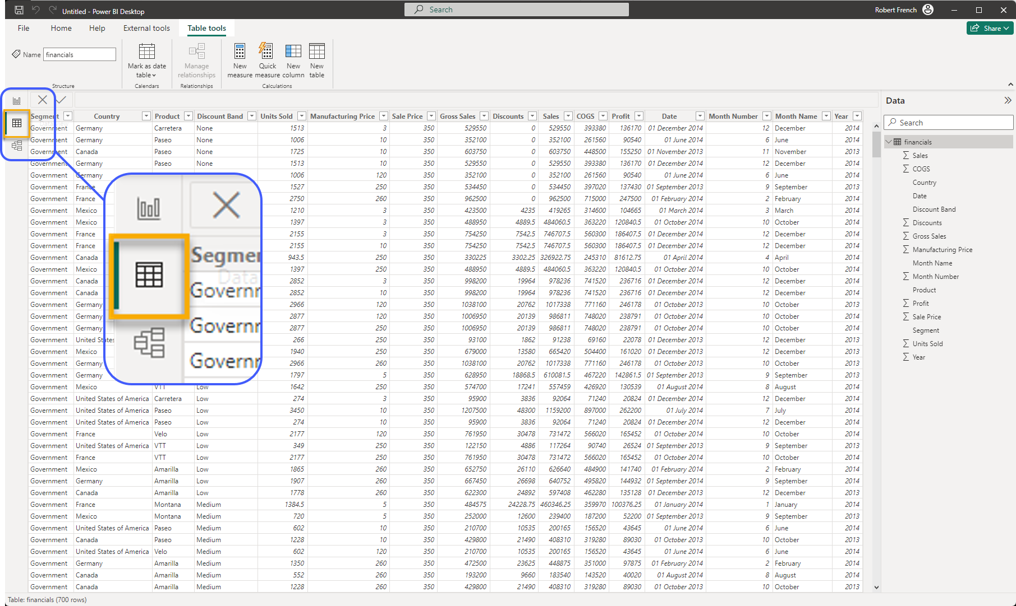
Data View

Slide 56
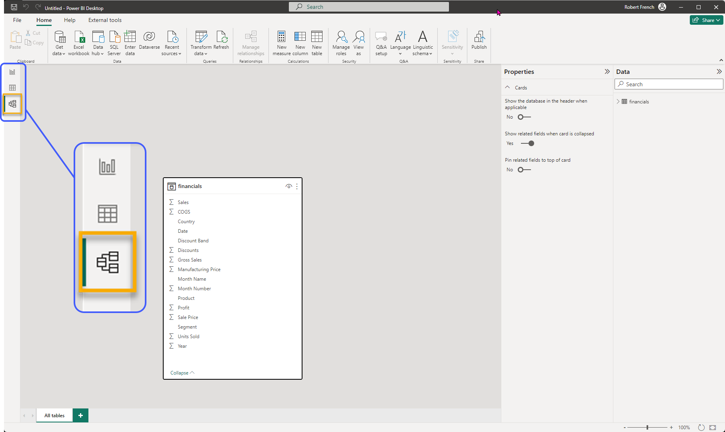
Modeling View

Slide 57
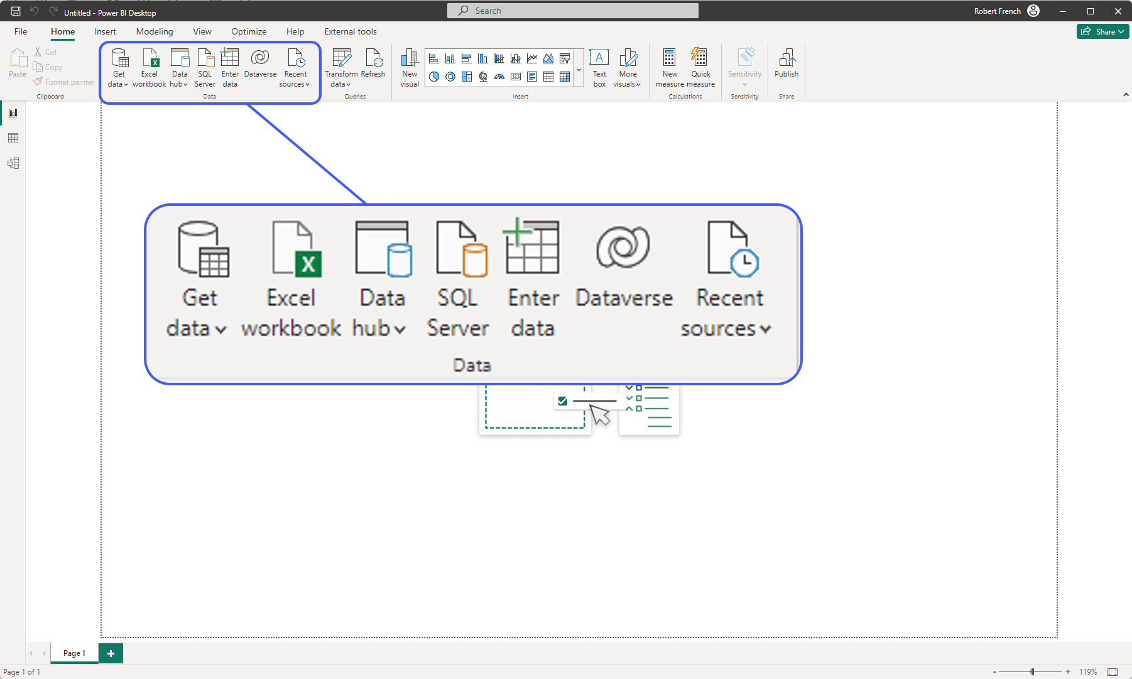
Notes:
This is to get data into Power BI desktop

Slide 58
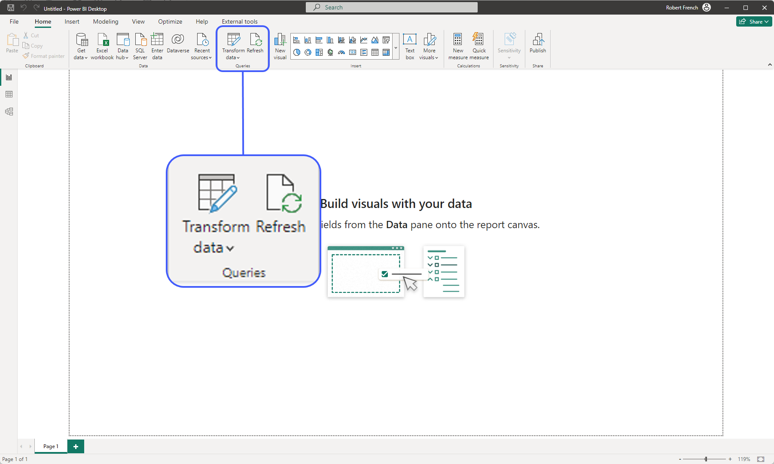
Notes:
Clicking on the ‘Transform Data’ takes to power query editor
Refresh re-runs the queries in the Power Query Editor

Slide 59
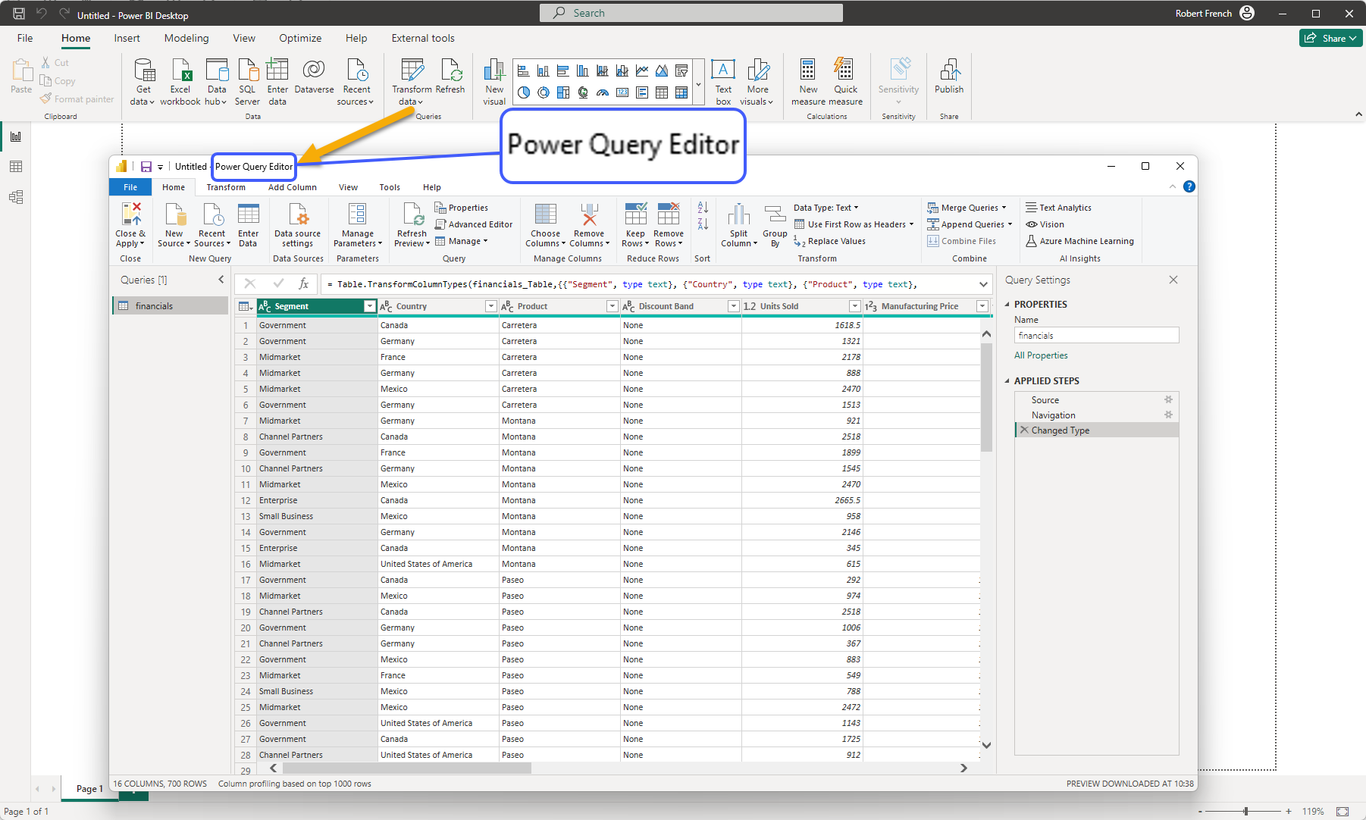

Slide 60
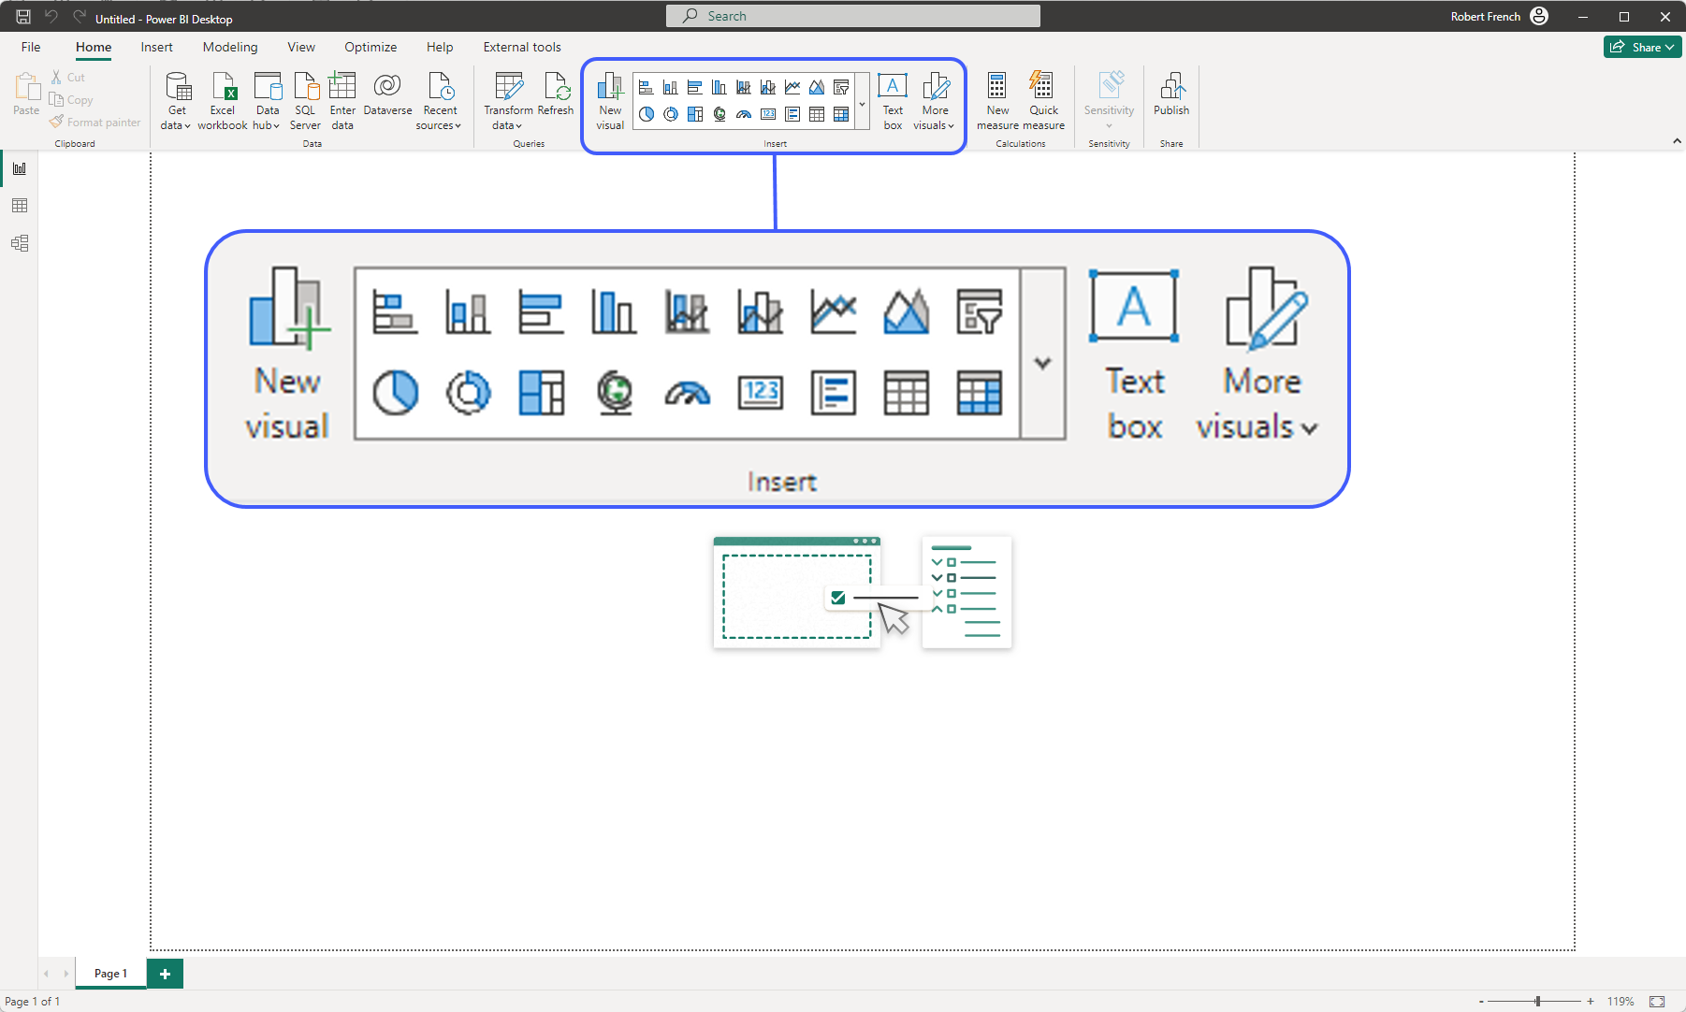

Slide 61
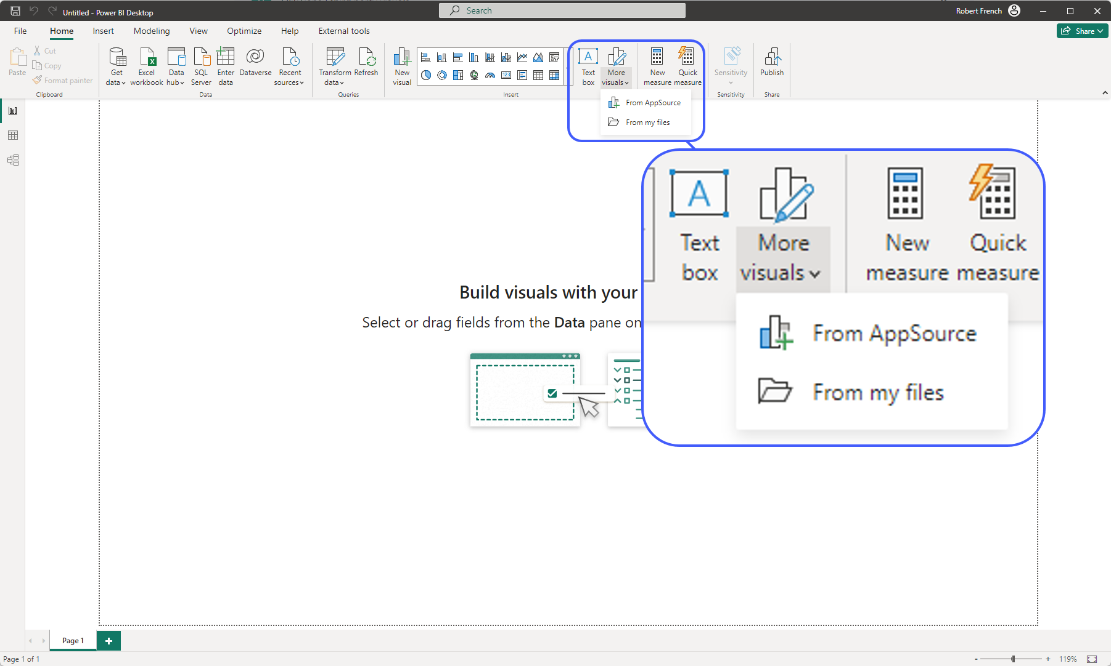

Slide 63
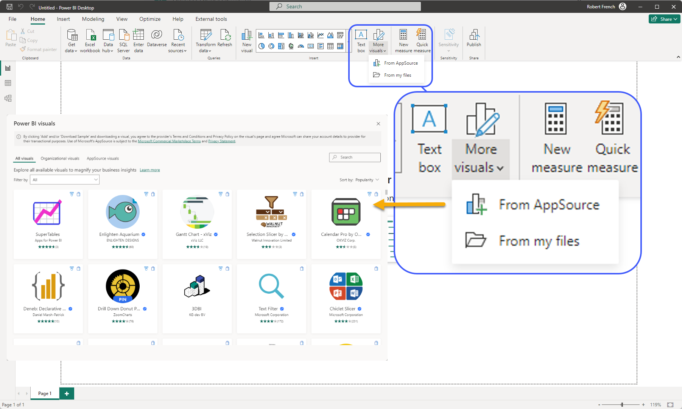

Slide 64
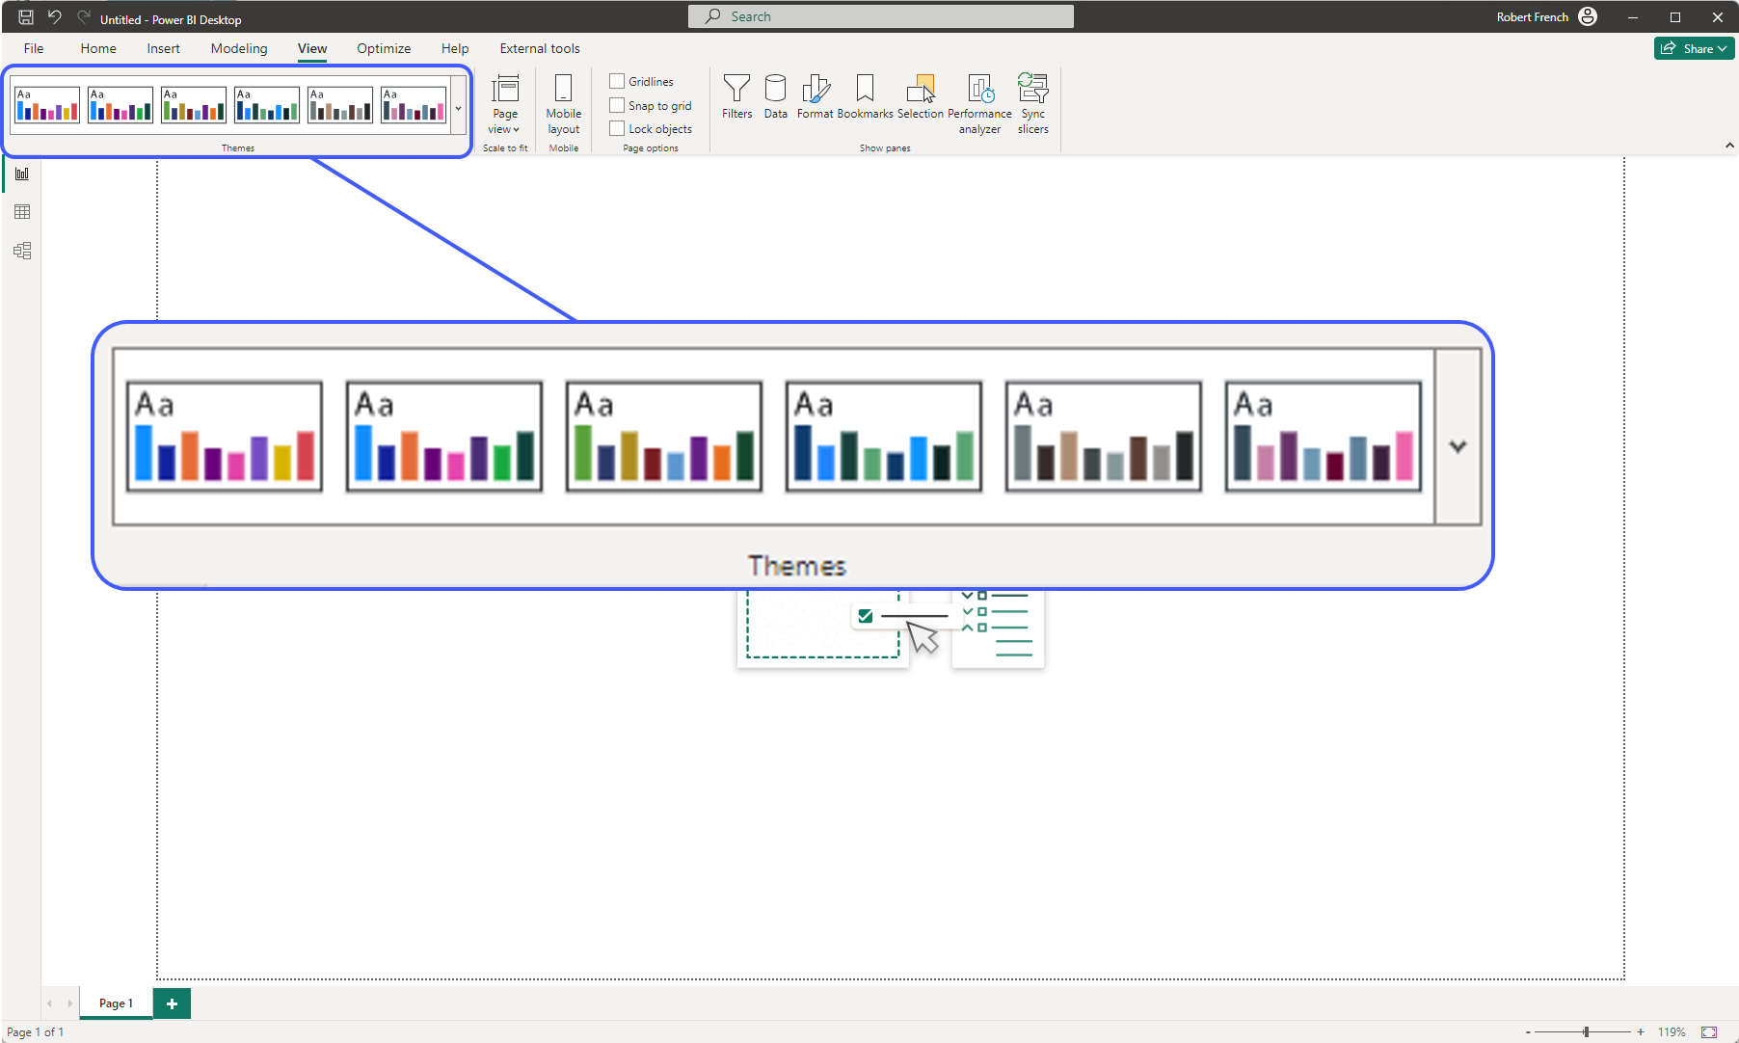

Slide 65
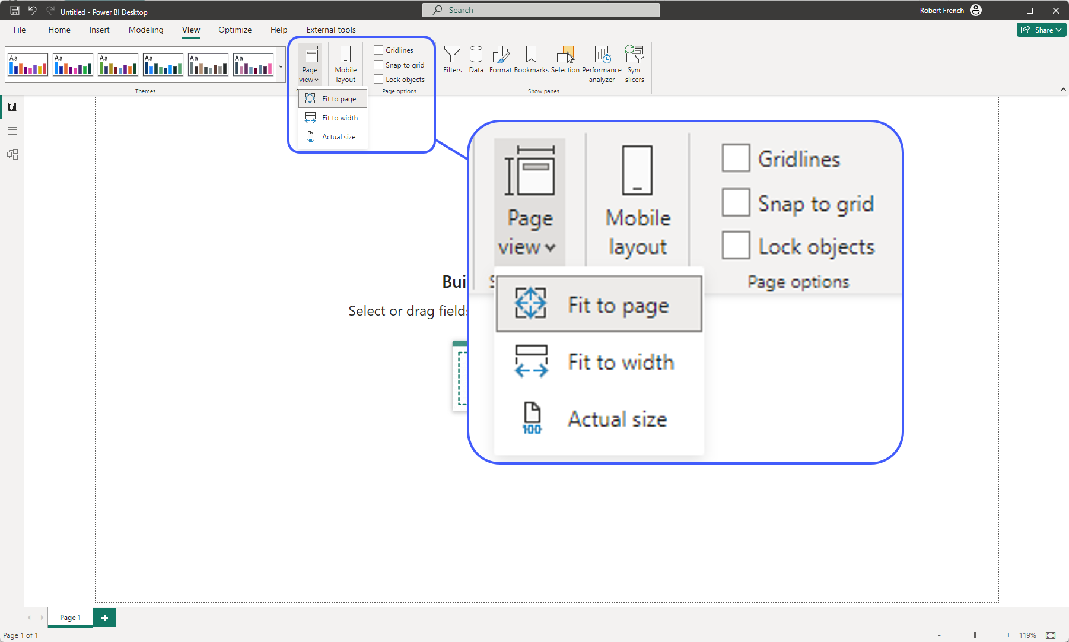

Slide 66
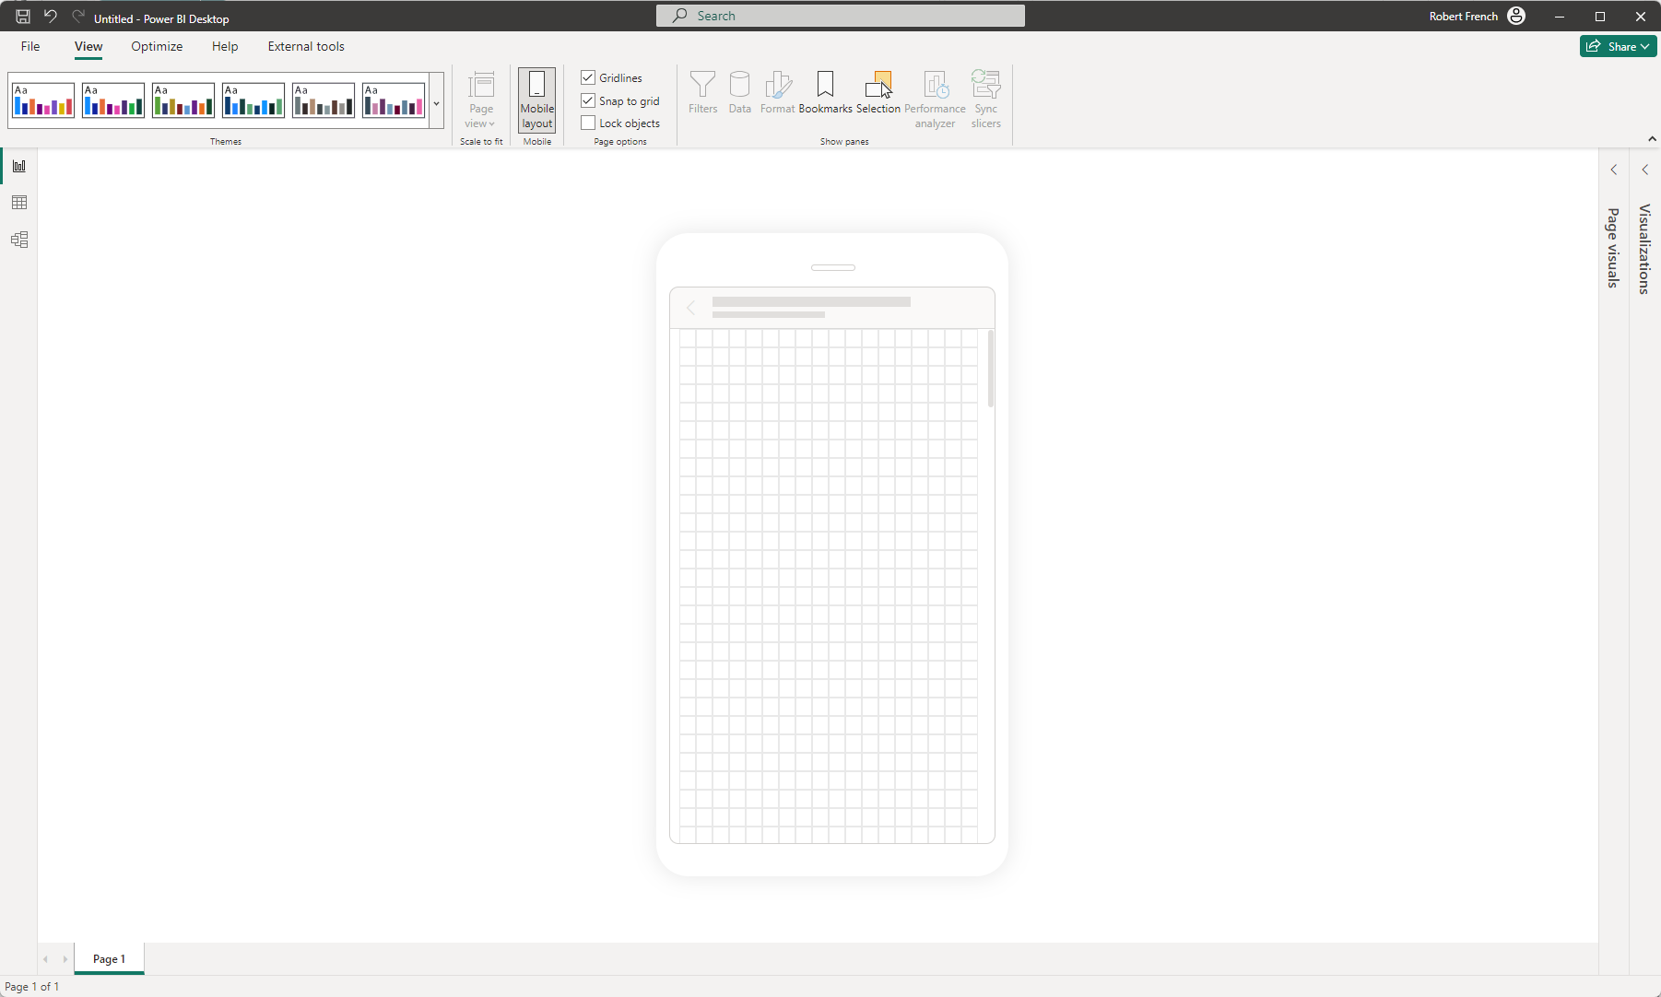

Slide 67
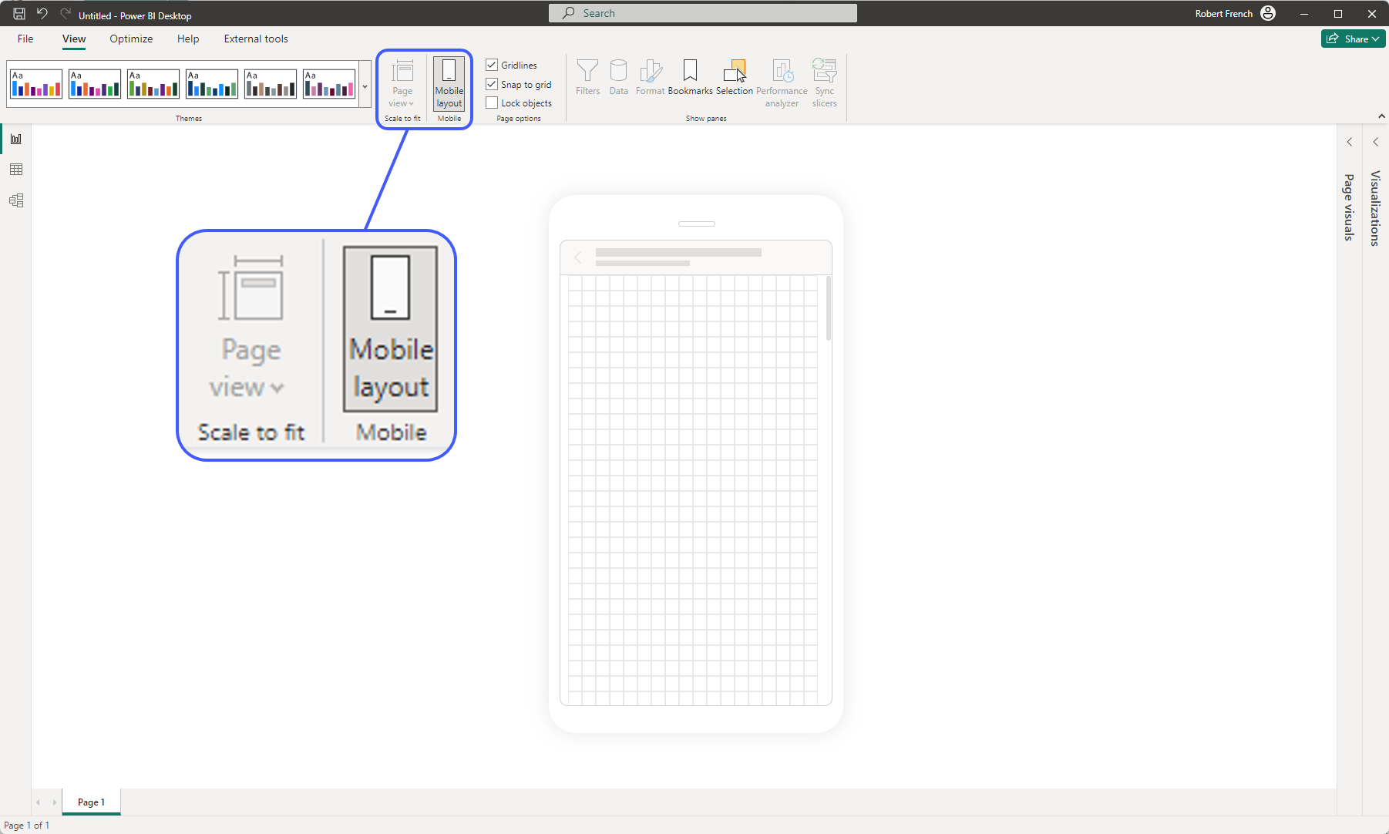

Slide 68
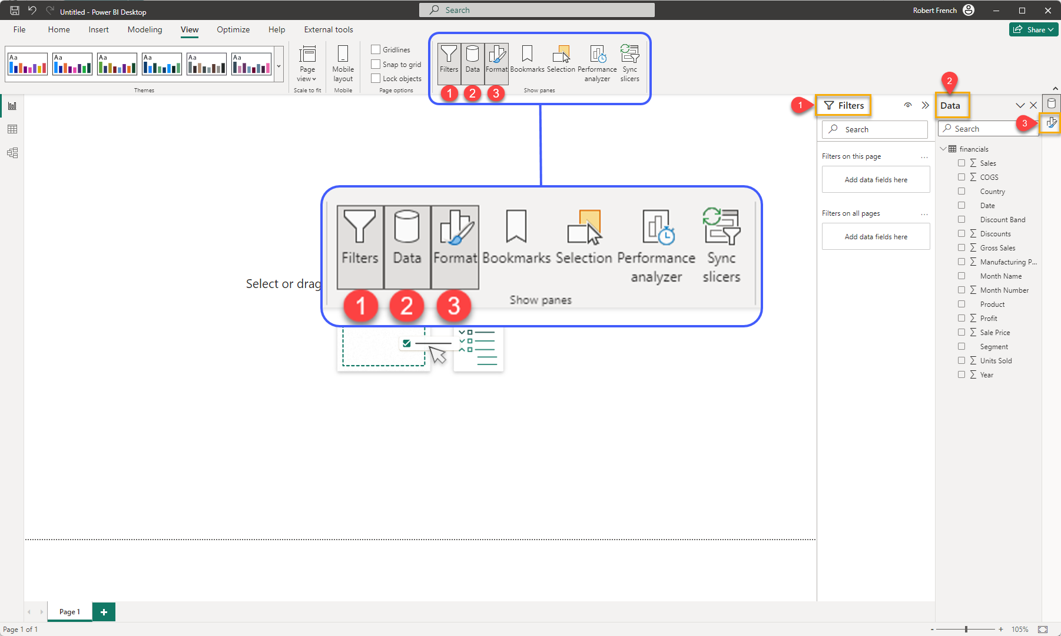

Slide 69
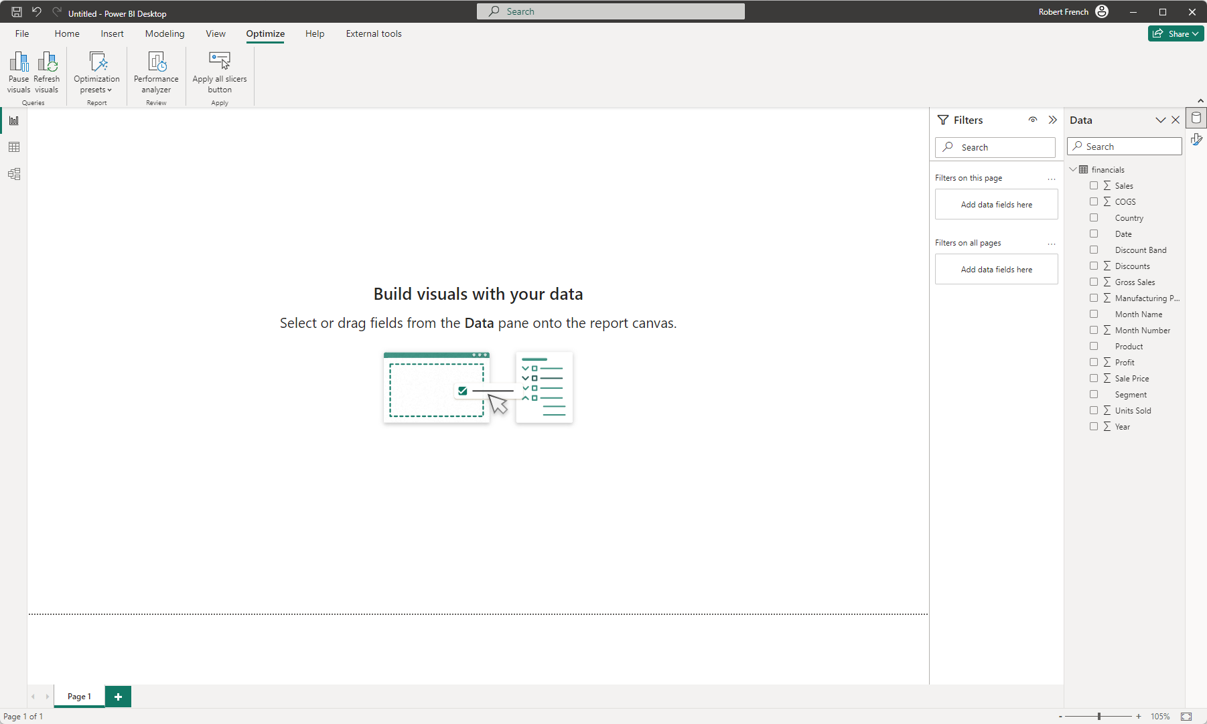

Slide 70
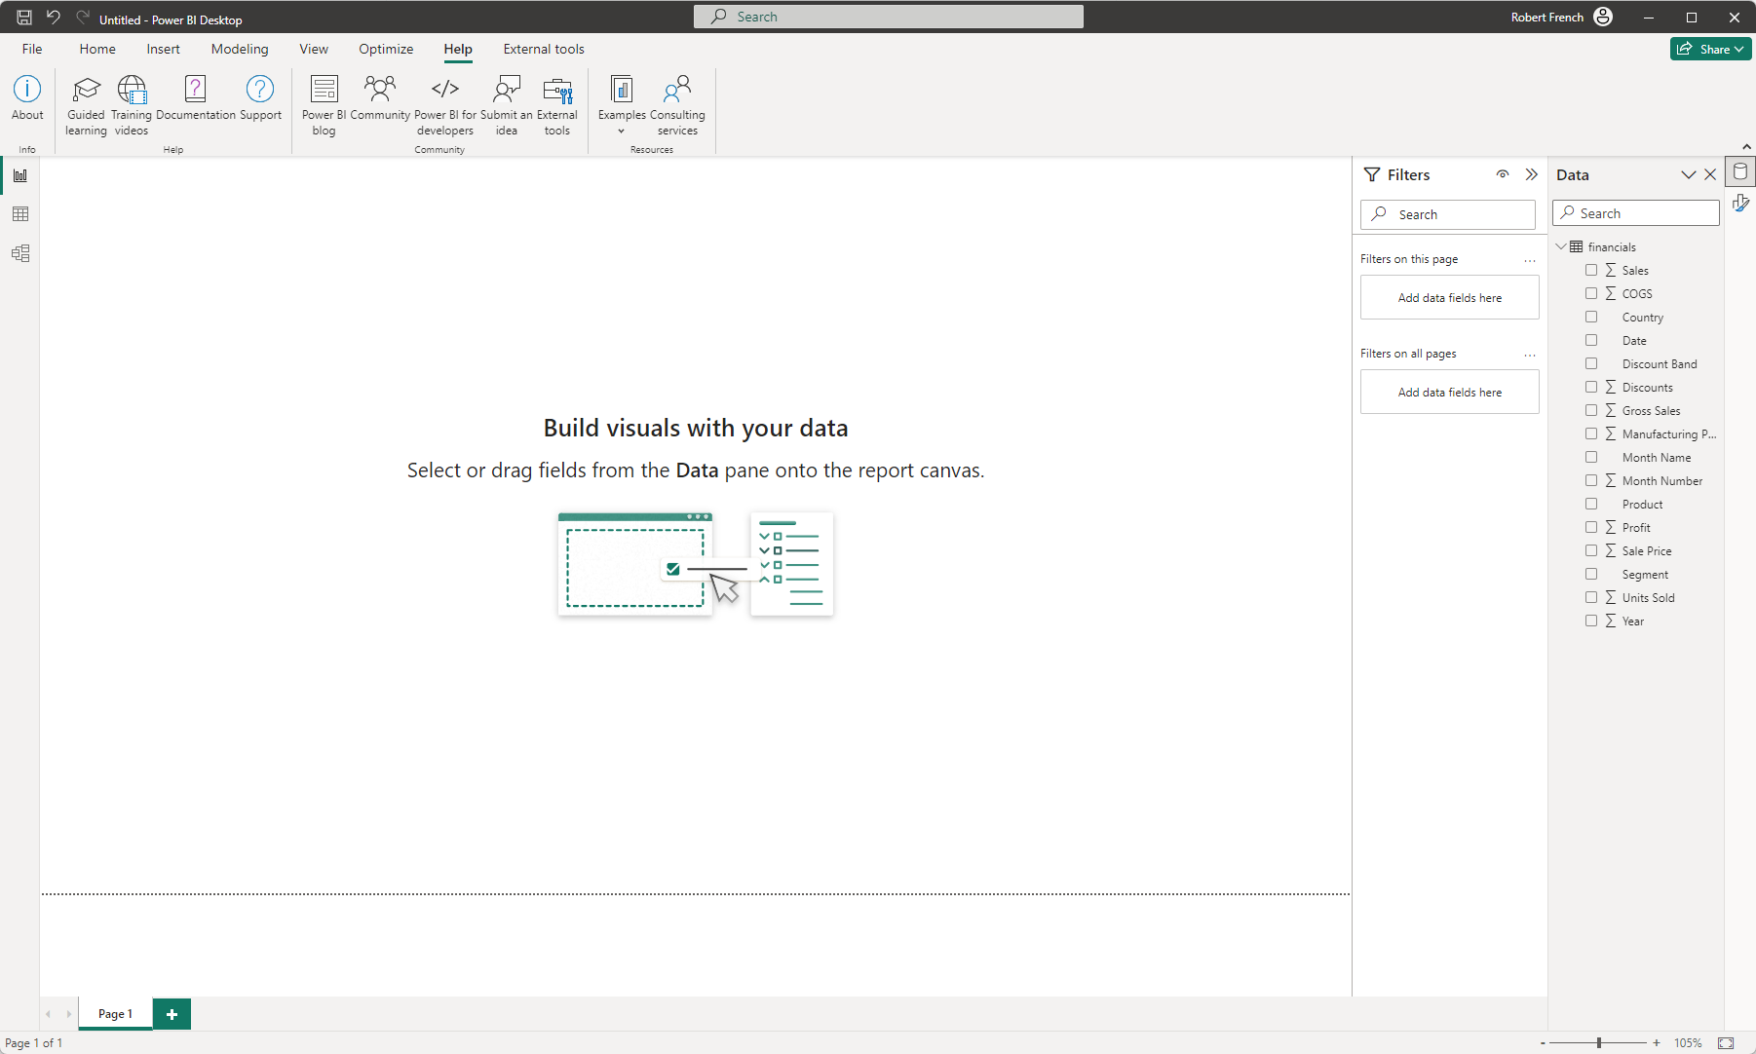

Slide 71
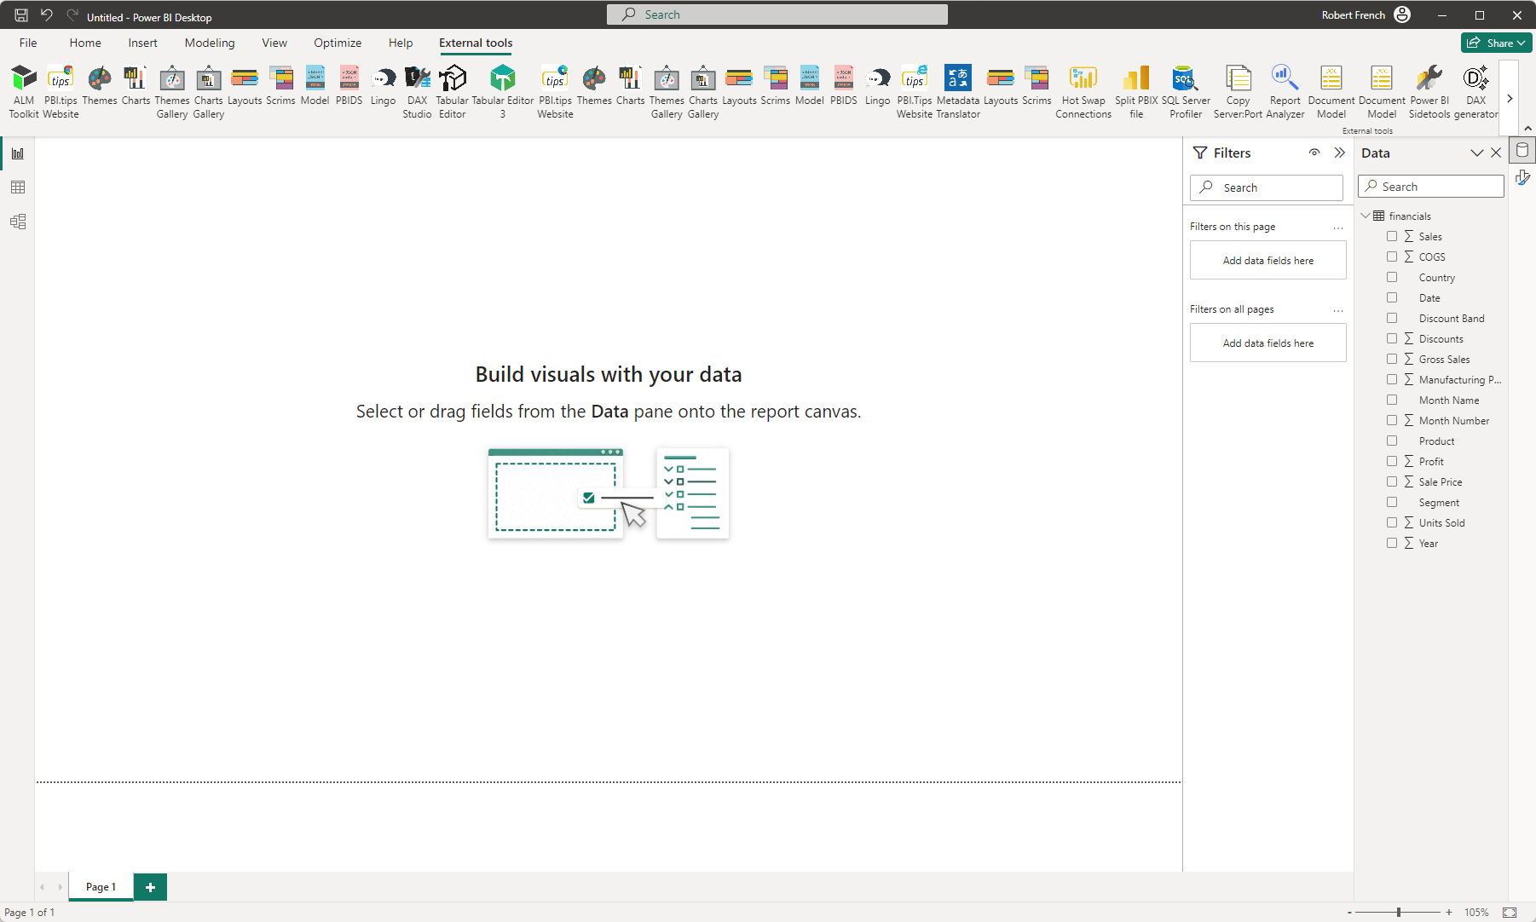

Slide 72
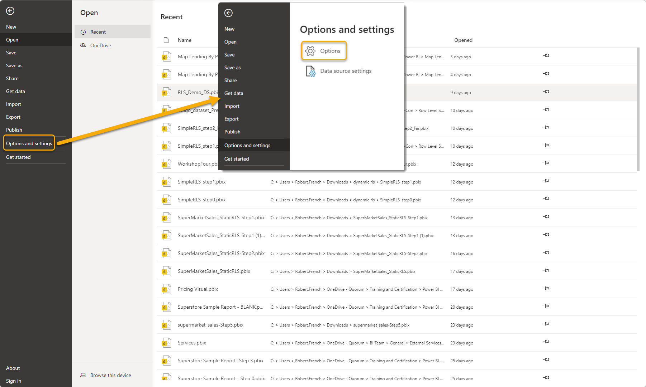

Slide 73
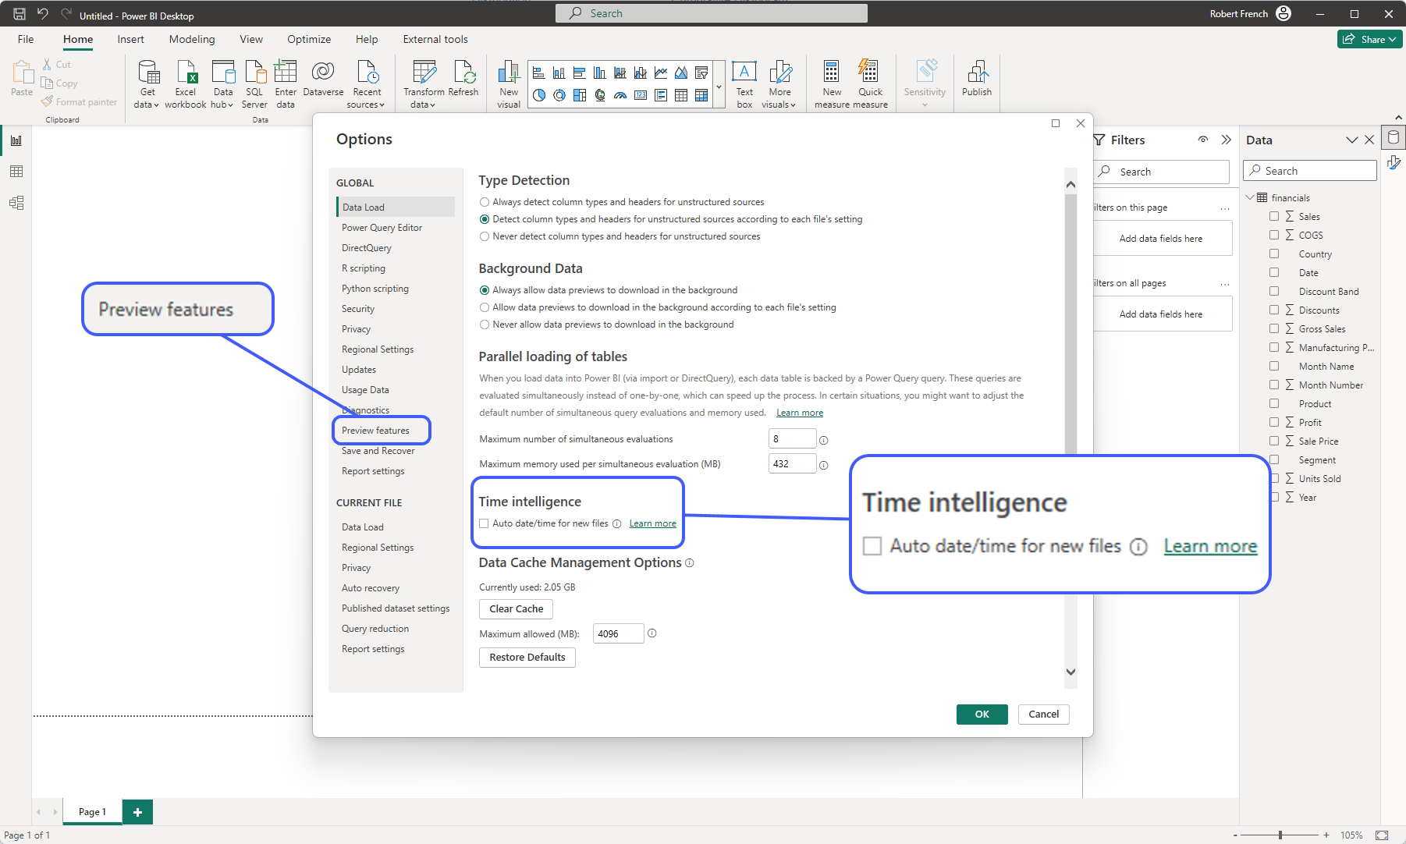

Slide 74
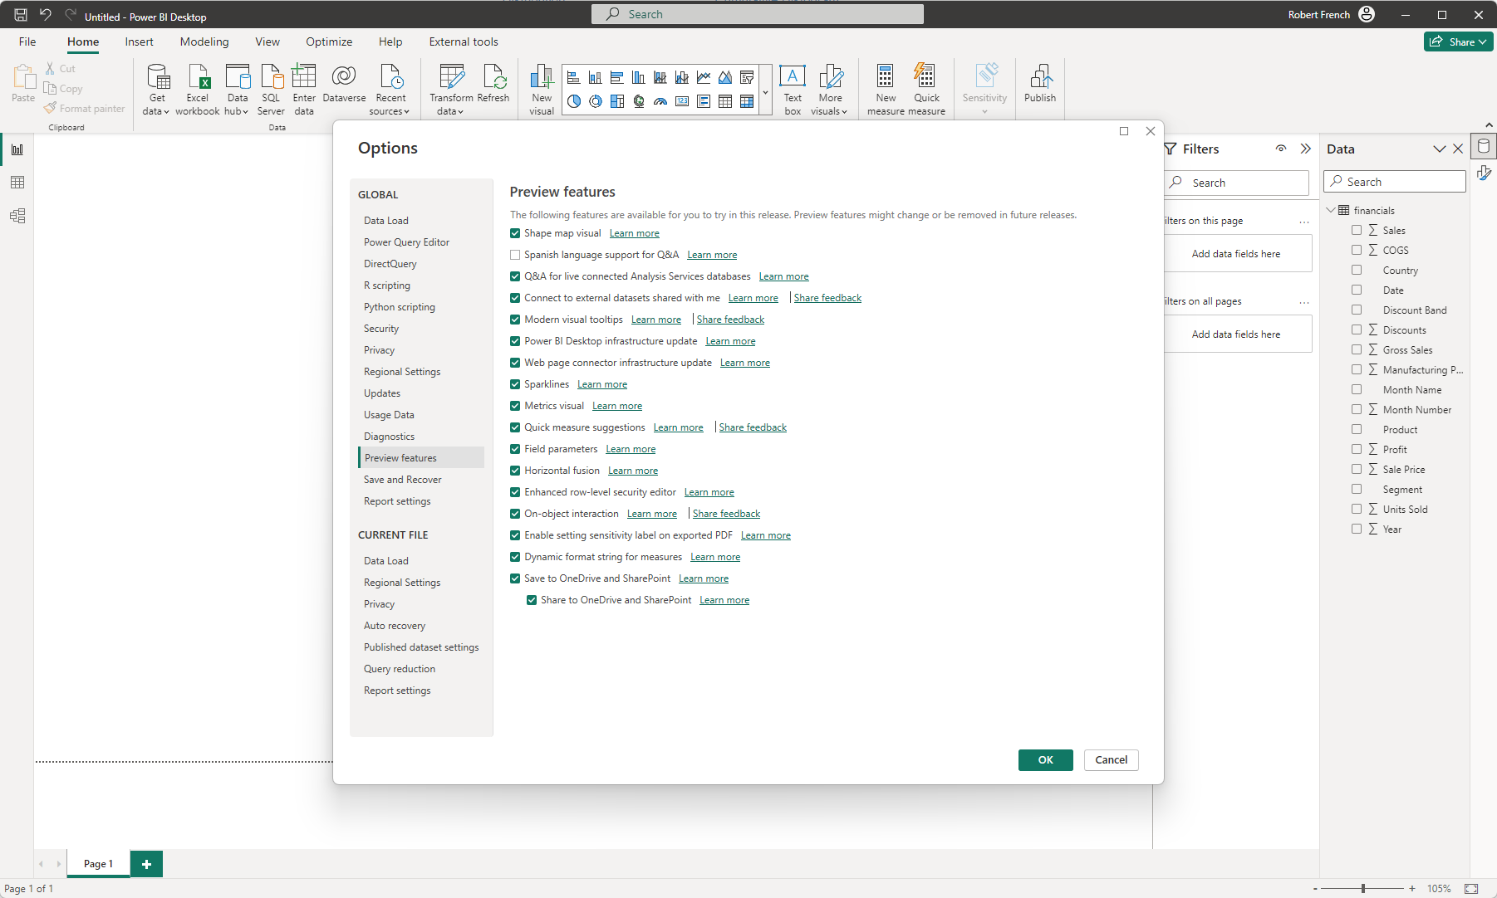

Slide 75
Data
Gateway
Power BI Mobile App
Desktop

Slide 76





iPads
iPhones
Tablet
Phone
Windows Devices

Slide 77
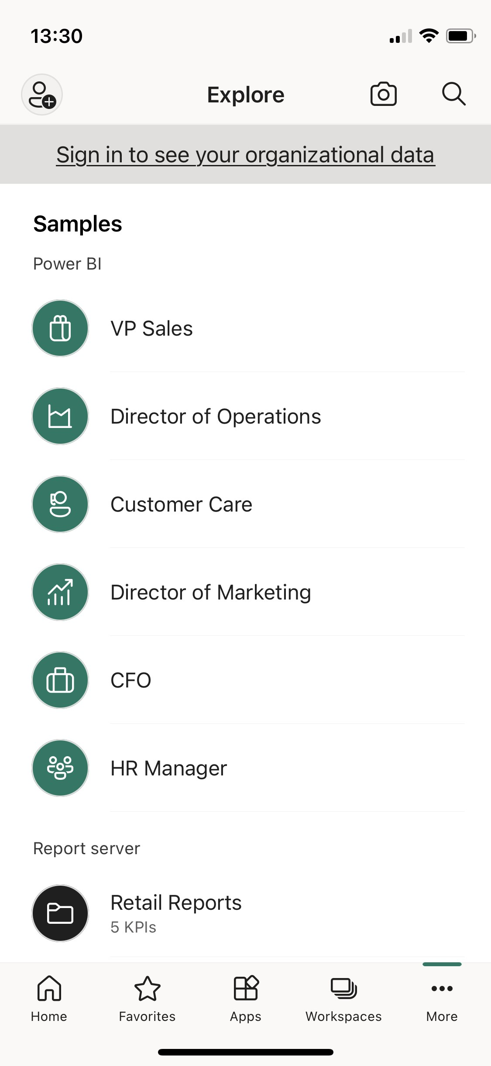
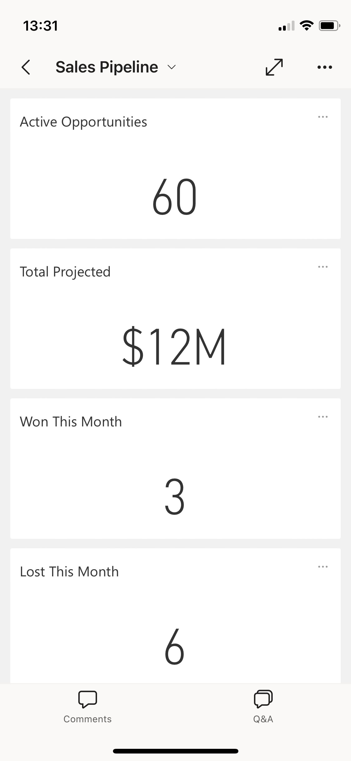
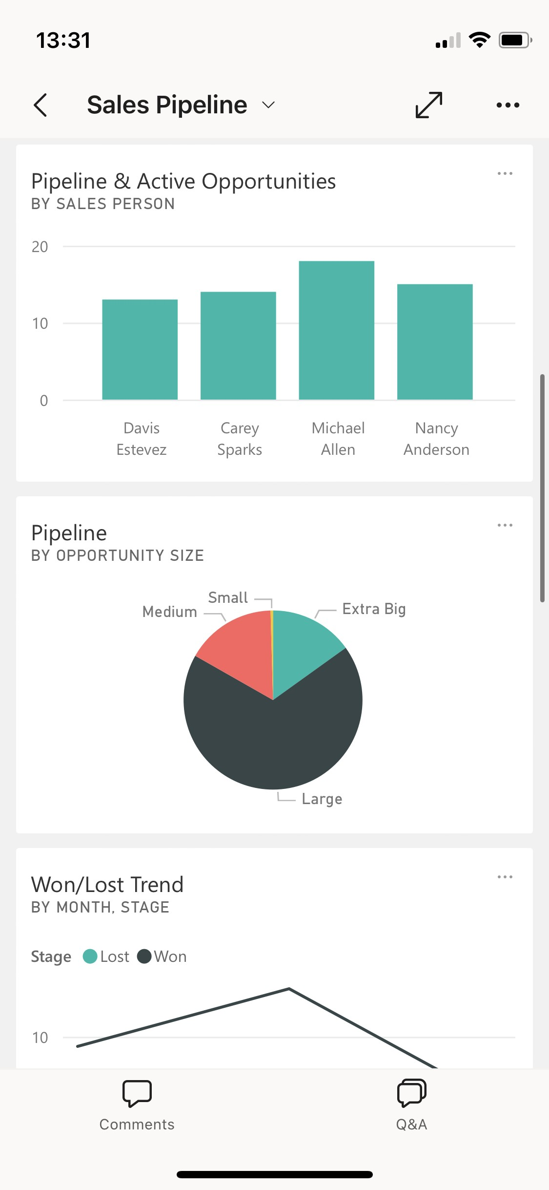

Slide 78
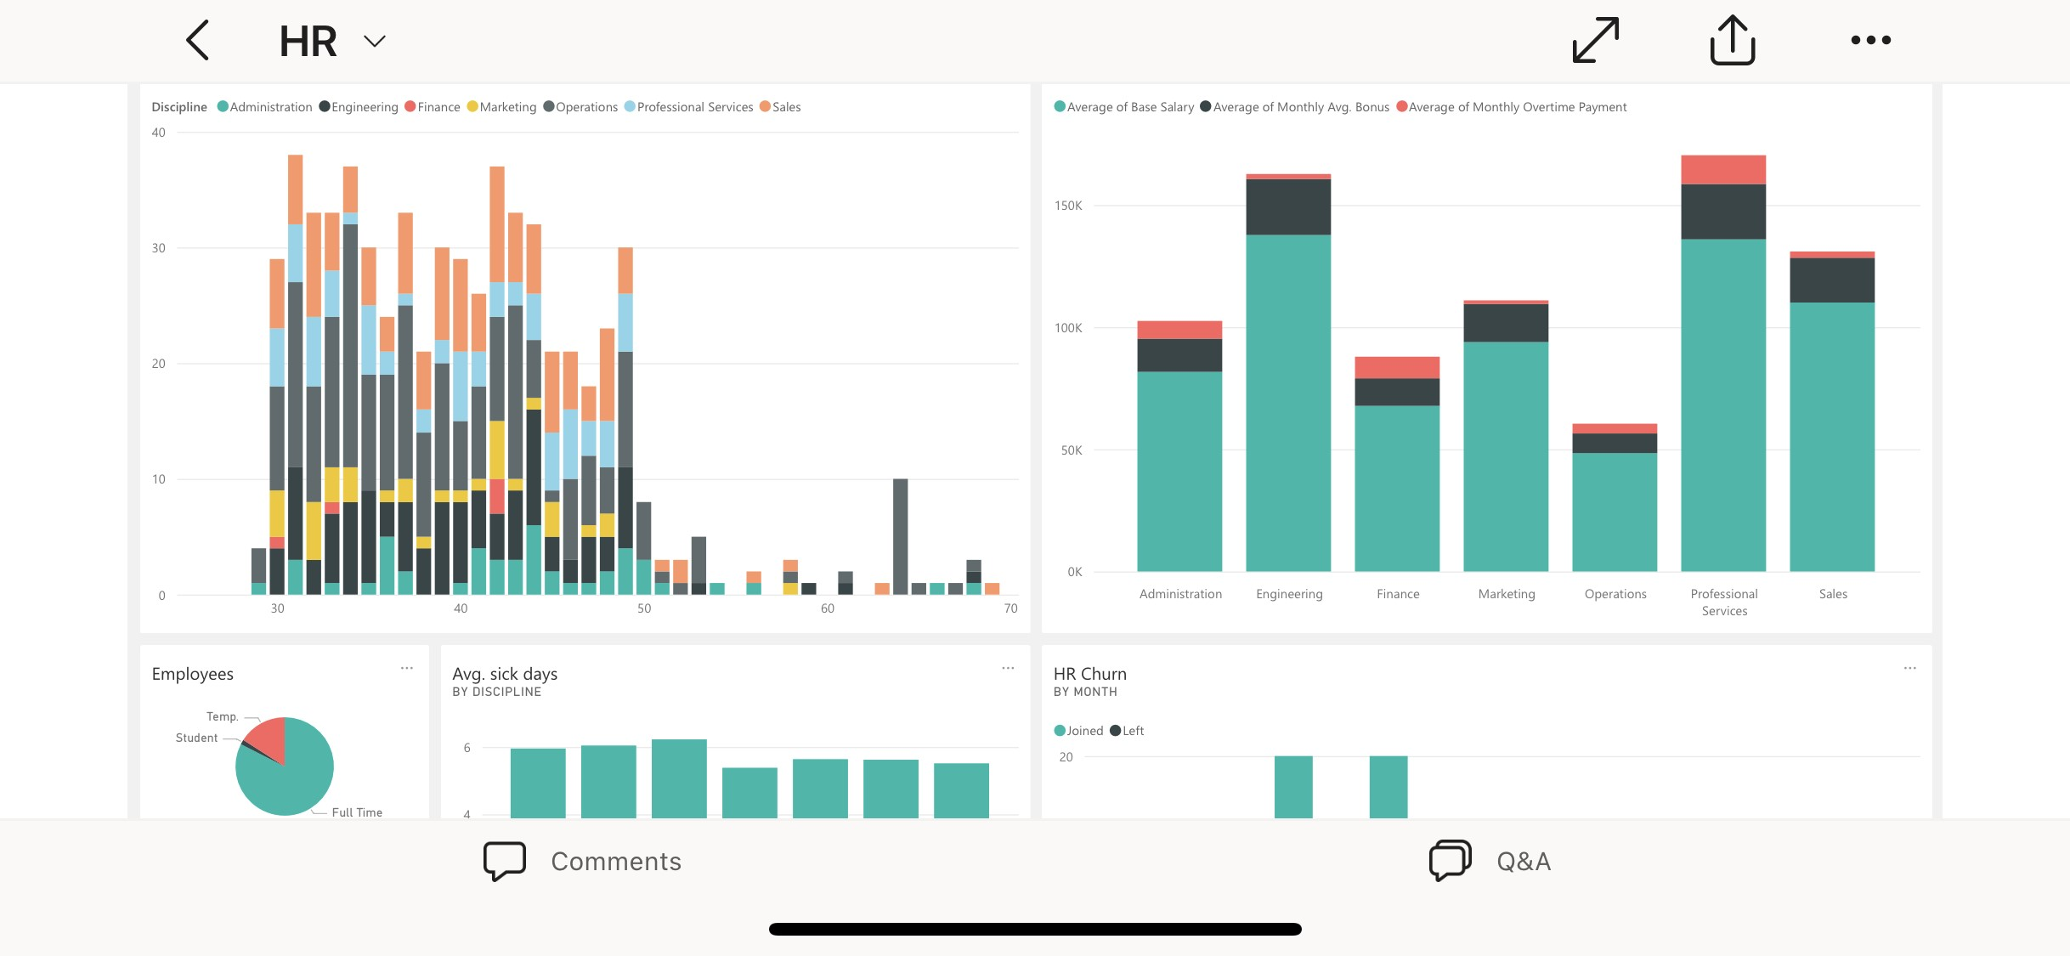

Slide 79
Power BI Report Builder
Data
Gateway
Power BI Mobile App
Desktop

Slide 80



Slide 81


Slide 82
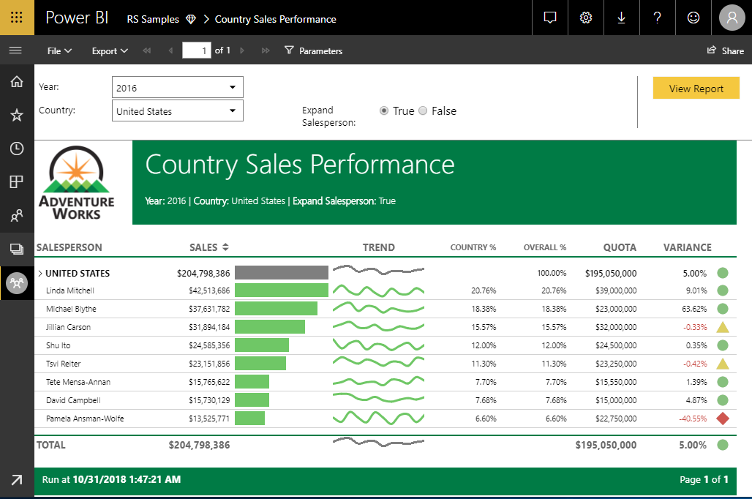

Slide 83


Slide 84


Slide 85


Slide 86


Slide 87


Slide 88


Slide 89

Notes:
You can publish to the Power BI service the same way as you do with Power BI desktop

Slide 90
Dataflows
Datasets
Streaming datasets
Dashboards
Power BI Apps
Scorecards

Slide 91

Notes:
https://www.coatesdatastrategies.com/diagrams

